Slide 1
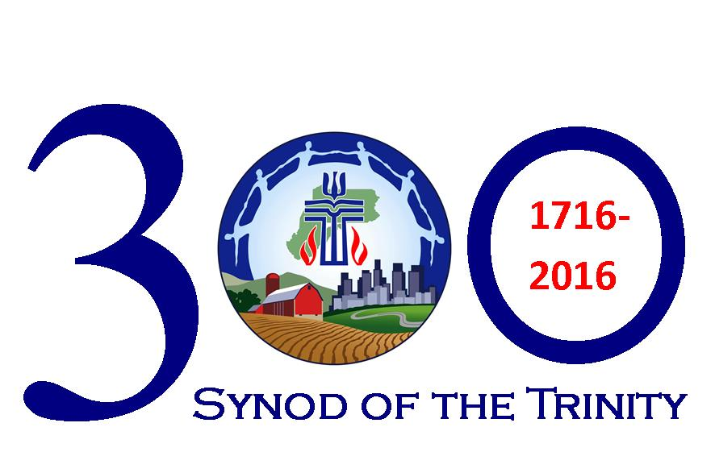

Slide 2
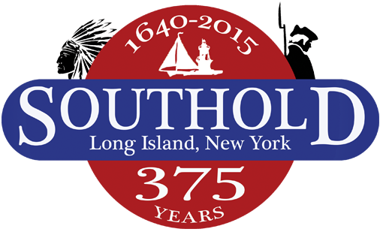
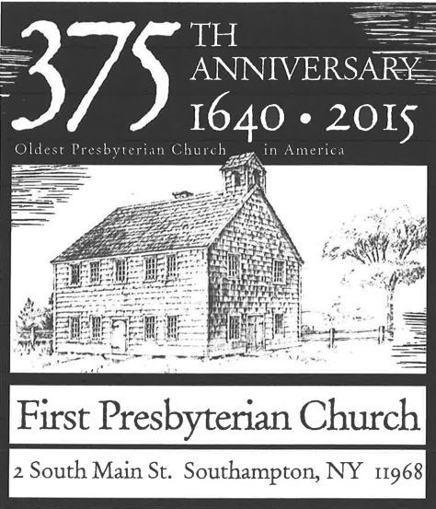

Slide 3
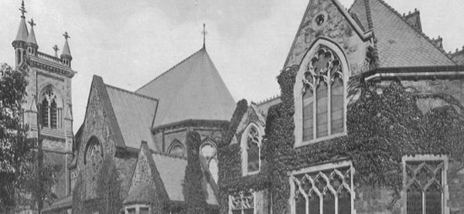
First Presbyterian Church of Philadelphia
(established 1698)

Slide 4
“The Synod” is formed in 1716.
Presbyteries of Philadelphia,
Long Island, New Castle
and Snow Hill comprise first synod.
First Synod meeting held in 1717
at First Presbyterian Church of Philadelphia.

Slide 5
Disagreements between Philadelphia and New York congregations cause
“The Synod” to split in 1741, and the “Old Side Synod of Philadelphia”
and “New Side Synod of New York”
are formed.
It was kinda like…

Slide 6
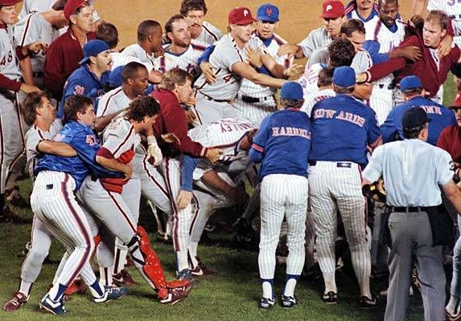
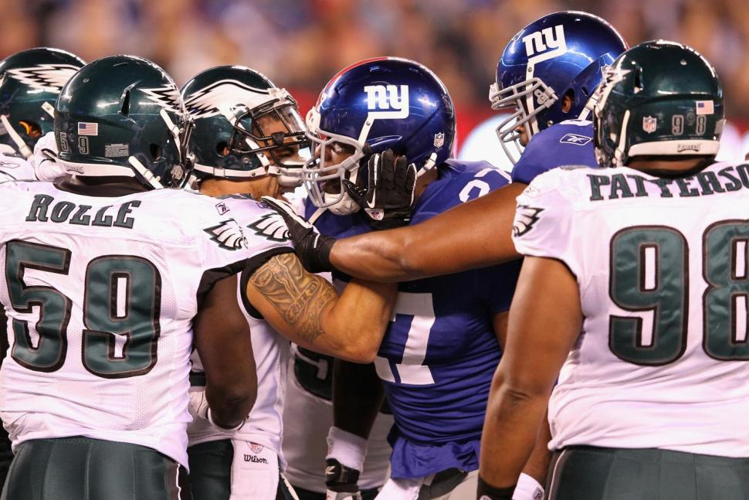

Slide 7
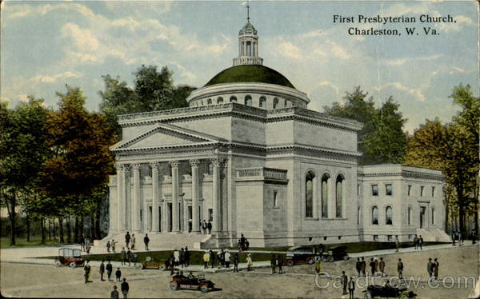
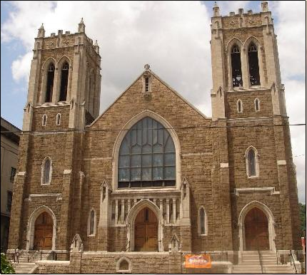
First Presbyterian Church of Charleston, WV
(established in 1819)
First Westminster Presbyterian Church
of Steubenville, Ohio
(established in 1801)

Slide 8
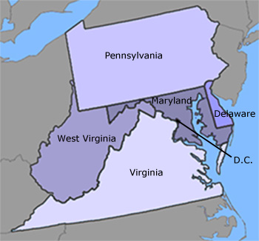

Slide 9
What’s in a name?
“The Synod”
“Old Style Synod of Philadelphia”
“Synod of NY and Philadelphia”
“Synod of Pennsylvania”
“Synod of PA and West Virginia”
“Synod of the Trinity”

Slide 10
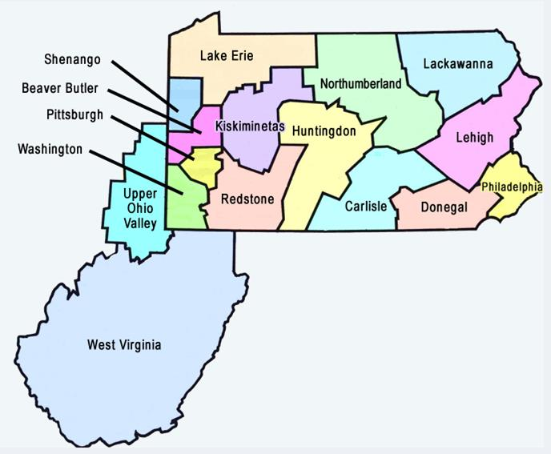

Slide 11
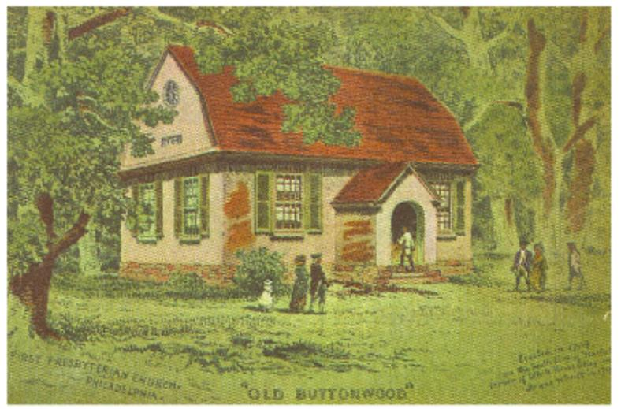
First Presbyterian Church of Philadelphia
“Old Buttonwood”

Slide 12
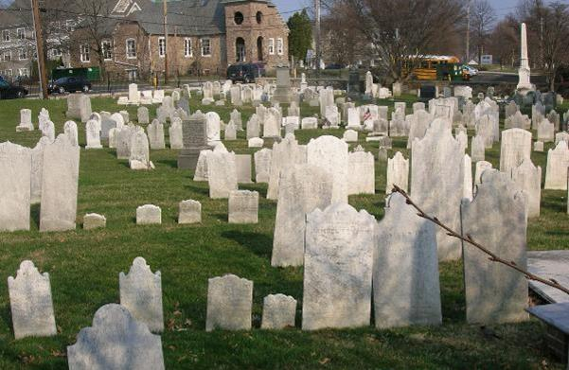
Cemetery at Abington Presbyterian Church

Slide 13
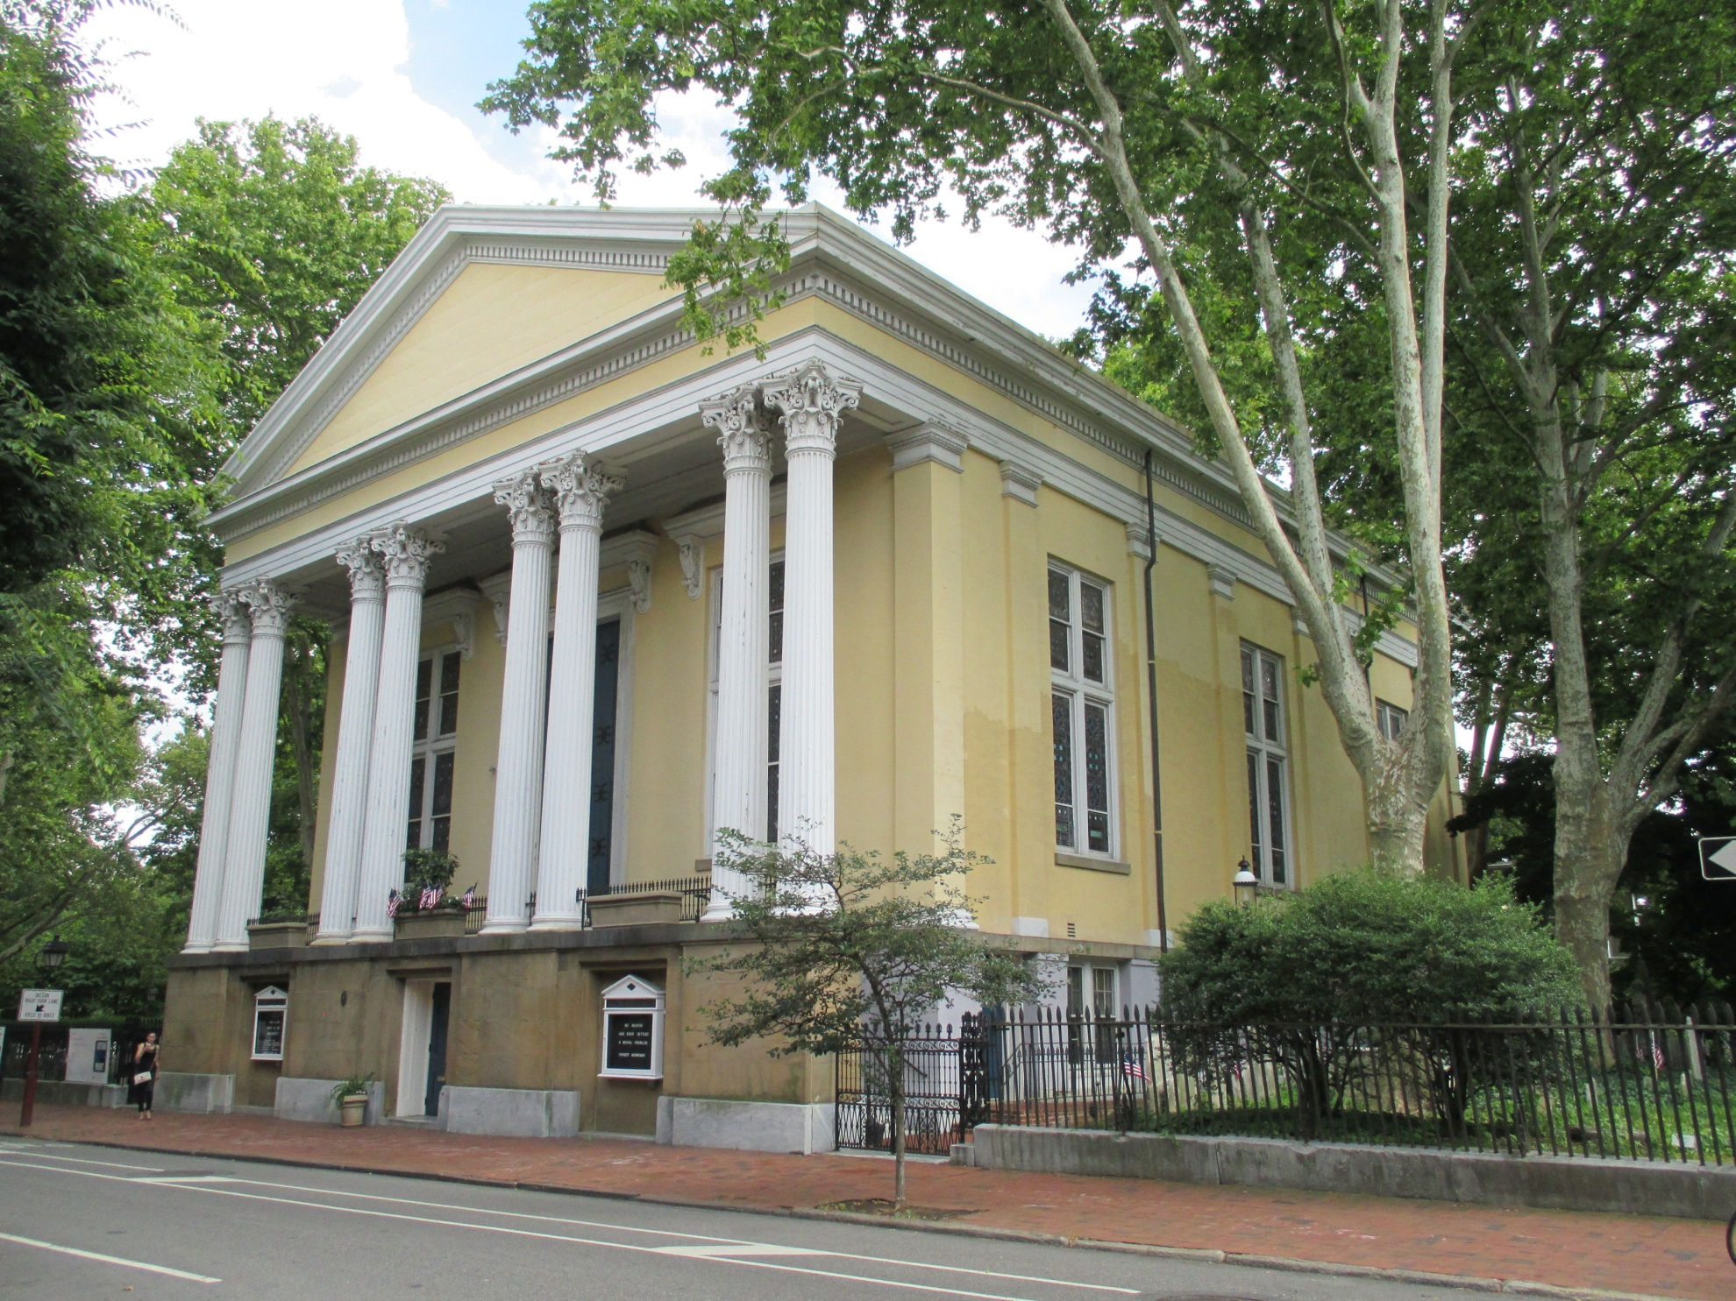
Old Pine Street Church

Slide 14
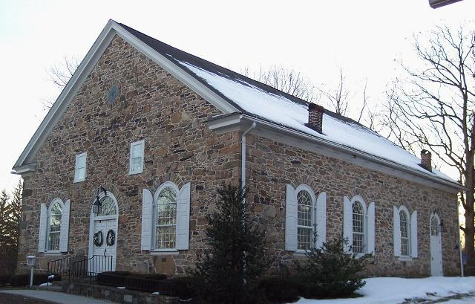
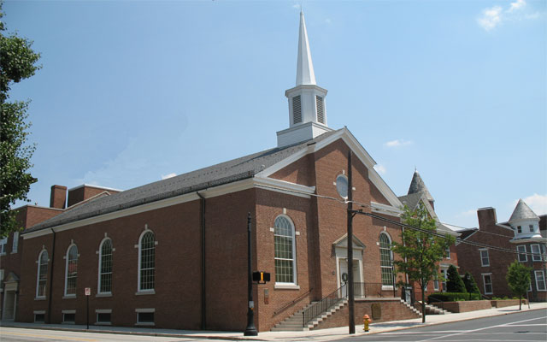
Great Conewago
Presbyterian
Church
Gettysburg
Presbyterian
Church

Slide 15
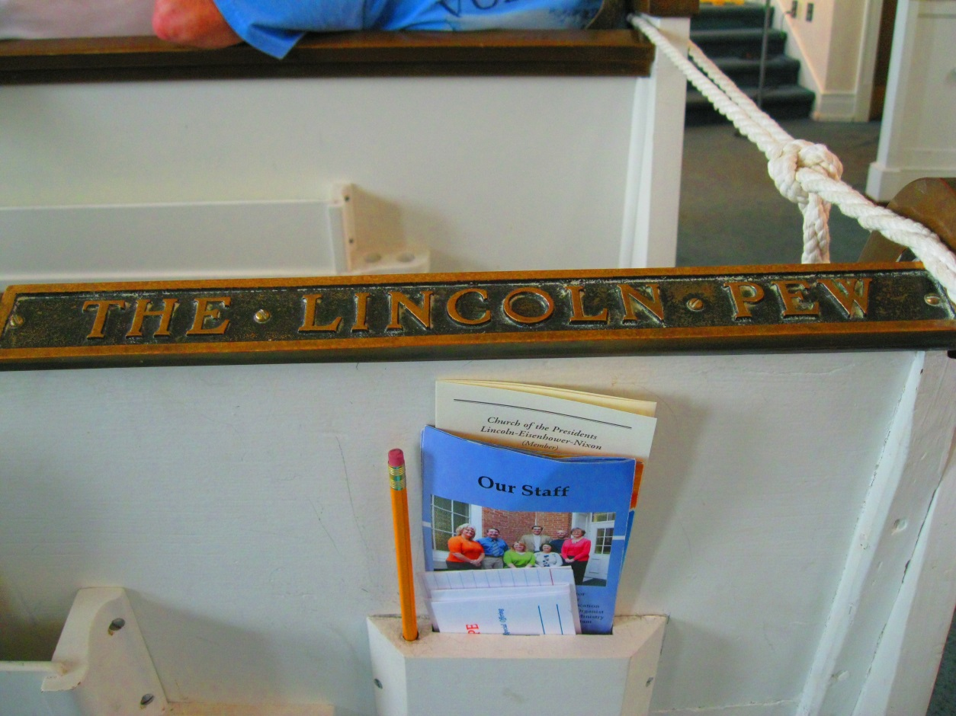
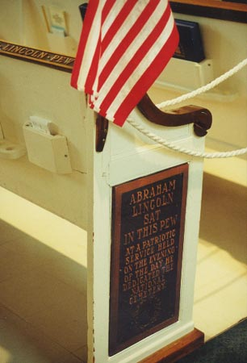
Lincoln was here!
Nov. 19, 1863
Gettysburg Presbyterian Church

Slide 16
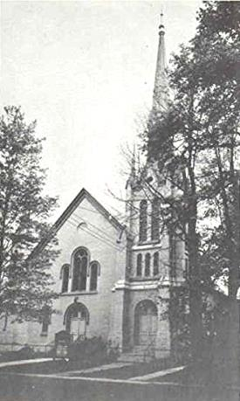
Montrose
Presbyterian Church

Slide 17
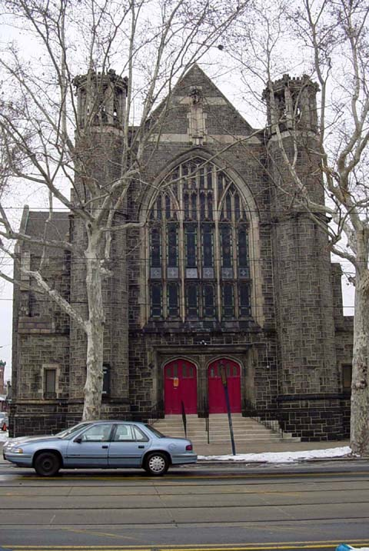
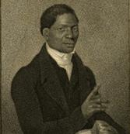
First African
Presbyterian Church
of Philadelphia
Rev. John Gloucester

Slide 18
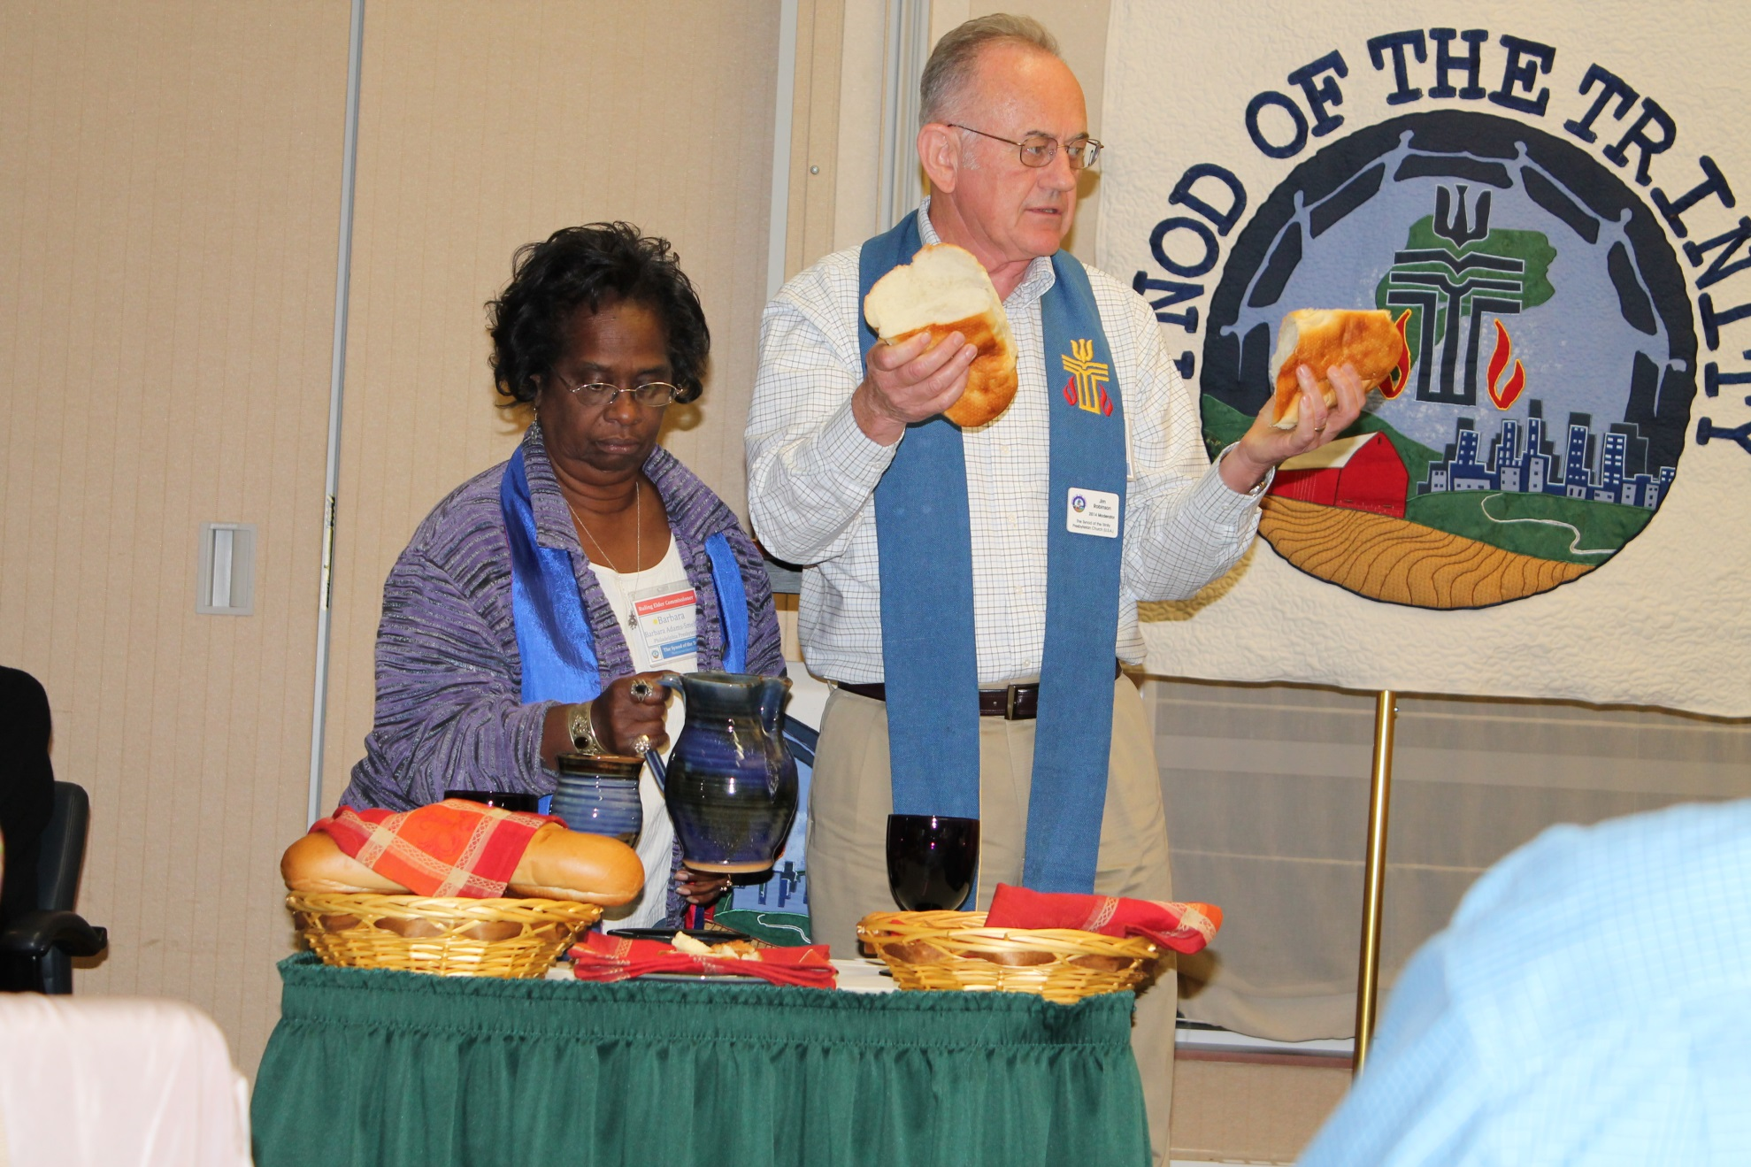
World Communion Sunday will occur on Oct. 4, 2015, the day before the fall Synod Assembly Meeting.

Slide 19
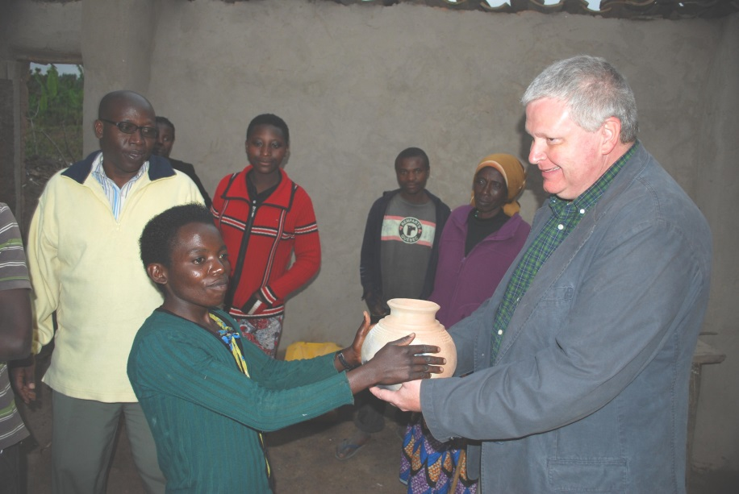
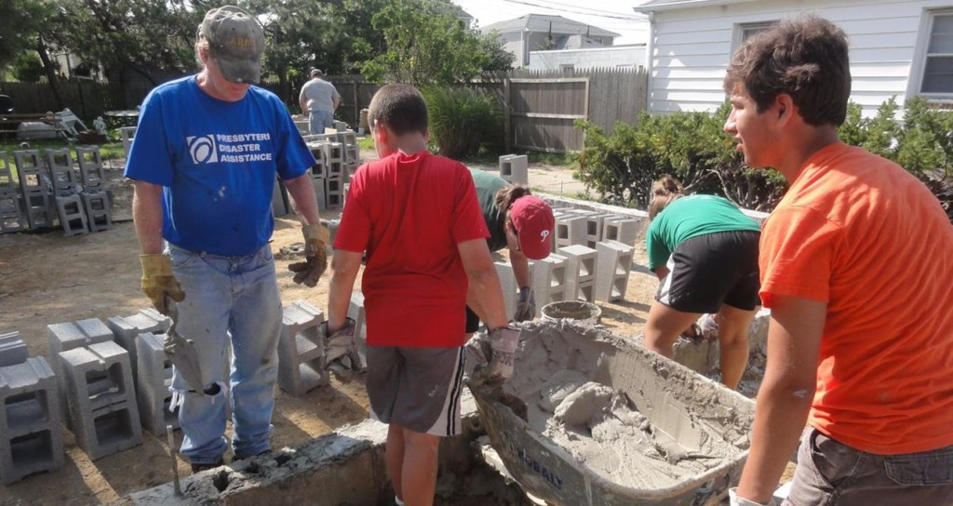
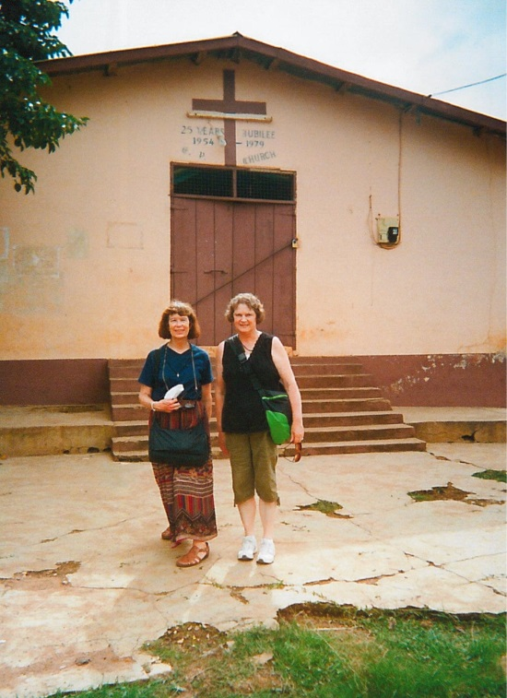
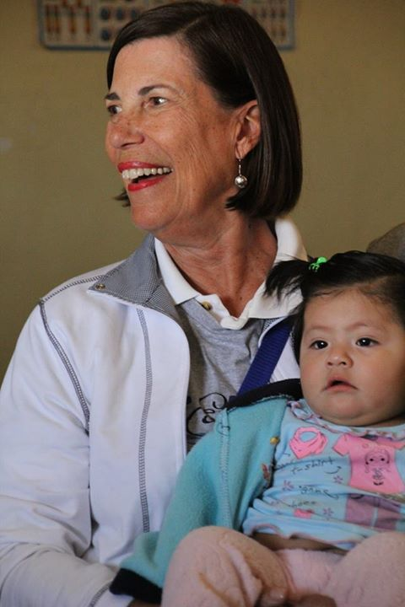
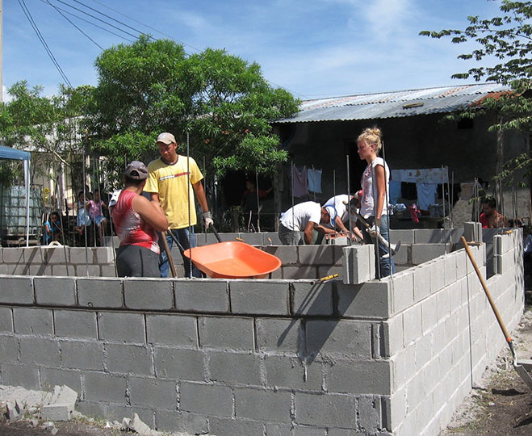
Brigantine, N.J.
Rwanda
Honduras
Ghana
Peru

Slide 20
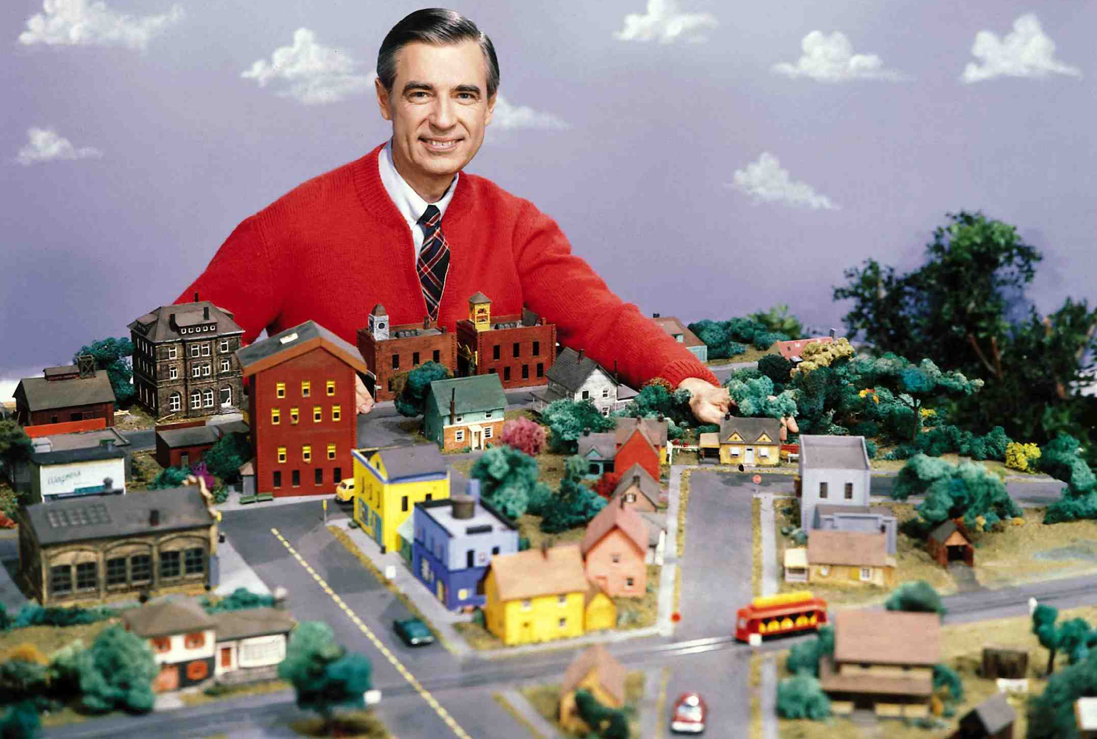
Rev. Fred Rogers
Graduate of Pittsburgh Seminary, PCUSA minister

Slide 21
Know of a historian? Let Mike Givler know!
mgivler@syntrinity.org

