Slide 1
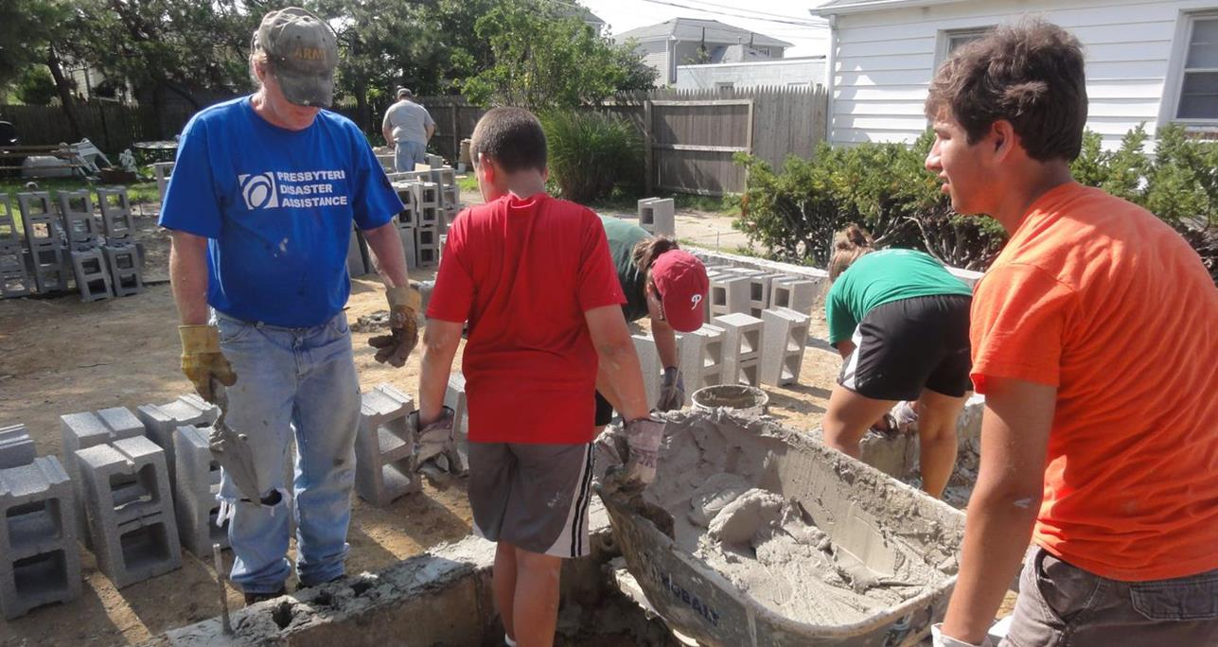
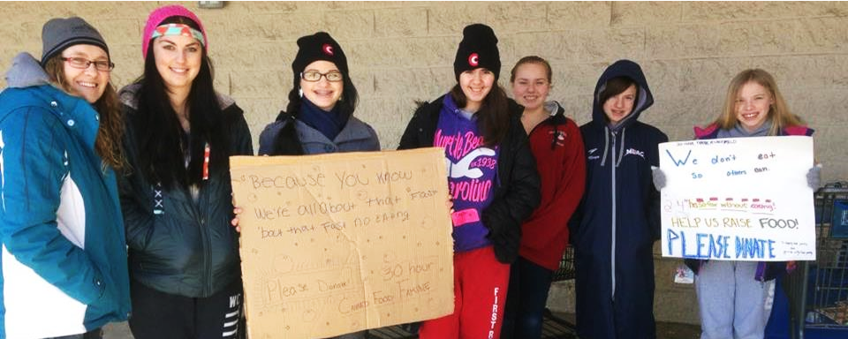
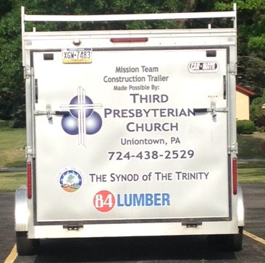
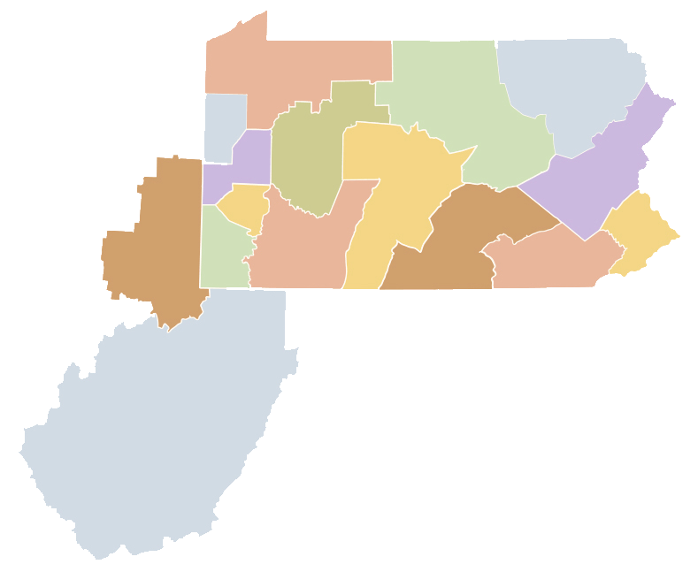
Synod of the Trinity
The
Being more
together

Slide 2
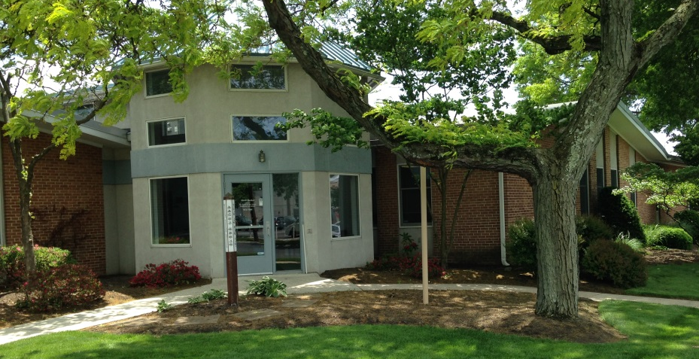
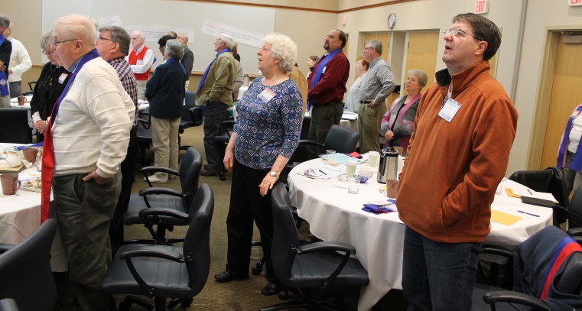
Supporting
For 300 years, the Synod of the Trinity has been a nurturing source of support and resources for its presbyteries as they seek to be faithful to Christ’s commission in their support of vital, mission-oriented congregations.
We work hand-in-hand with the ministry and mission of our presbyteries as they seek to support the witness of congregations, to the end that the church throughout its region becomes a community of faith, hope, love and witness.
The Synod supports presbytery leadership by offering training, networking and continuing education opportunities such as: Executive Presbyter Forums, COM/CPM Training, PJC Training, cost-sharing for education for first-time presbytery executives and access to demographic ministry analysis.
In addition, the Synod participates in objectives relating to the larger mission strategies of the Presbyterian Church (U.S.A.) General Assembly.
October 2015 Synod Assembly
Synod office, Camp Hill, PA
2

Slide 3
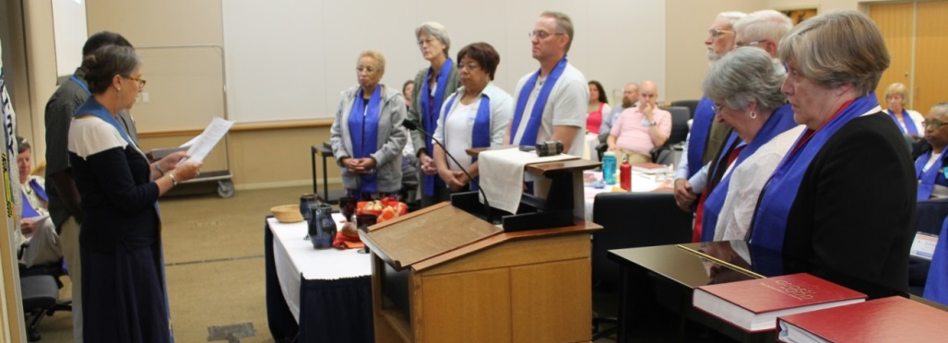
Our calling
Synod’s primary end:
As part of the body of Christ, the Synod, through the responsible use of shared resources, supports and challenges member presbyteries to be vital, innovative and faithful in their collaborative and distinctive callings.
Secondary ends:
Connecting presbytery leadership for coordination, spiritual support and sharing best practices.
Encouraging innovation in, between and among presbyteries through the use of human, programmatic and financial resources.
Providing services of education and nurture as requested by member presbyteries.
Extending partnership of member presbyteries in joint and shared mission and ministry.
Nurturing relationships within the larger church for the purpose of greater witness.
Fostering conversation and action for the promotion of social righteousness.
Leading
The Synod Assembly is comprised of 32 commissioners representing all 16 presbyteries plus six racial ethnic at-large commissioners. The Governing Commission acts on behalf of the Synod Assembly throughout the year. It includes the Synod Moderator and Vice Moderator, eight elected commissioners, four ex-officio Synod staff members and two advisory Executive Presbyters.
Governing Commission elected at
June 2015 Synod Assembly Meeting
3

Slide 4
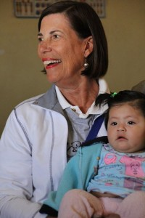
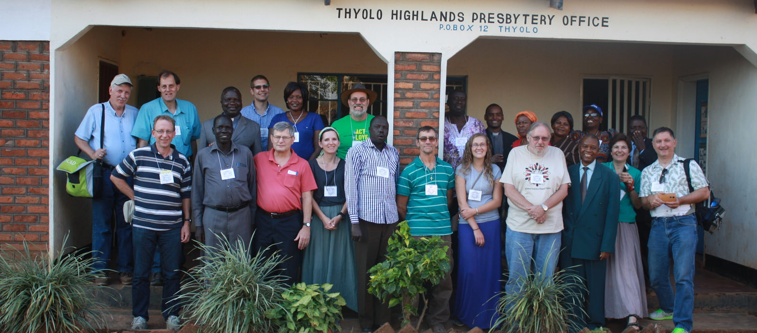
Making a difference
Each year, the Synod of the Trinity awards hundreds of thousands of dollars to presbyteries and churches. Moneys are generally distributed in the following ways:
Peacemaking Grants
Available for peacemaking efforts for projects and programs developed by Synod congregations or presbyteries. Funds are earmarked for activities for programs, projects and/or activities that extend the peace of Jesus Christ.
Mission Travel Grants
This grant is for travel related to a deeper understanding as we live out our faithfulness to God in the larger world.
First PC of Charleston, WV, in Peru
Pittsburgh and Beaver-Butler Presbyteries in Malawi, Africa
4

Slide 5
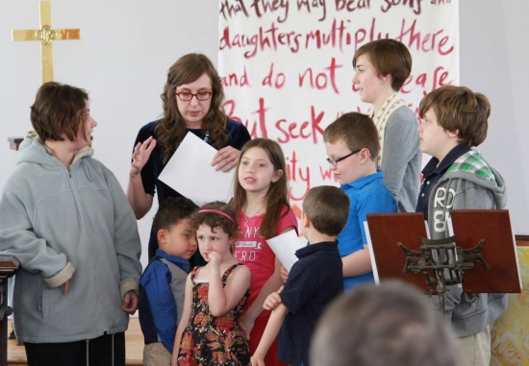
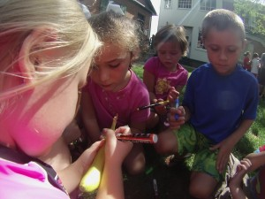
Making a difference
Innovation Grants
Intended to provide a means for funding and encouragement to presbyteries to stimulate innovation and creativity in mission and ministry. Among the objectives are to encourage financial stewardship by providing “partnership” dollars wherever possible.
Some examples of the work being done through Innovation Grant money are:
West Virginia Institute for Leaders in Ministry
Leadership development program designed to help ministers and educators gain valuable leadership skills
The Studio at Beacon
Created weekday afternoon workshops that are targeted for youth in Kensington, an area of Philadelphia
Traveling Day Camps
Through the Krislund Camp & Conference Center, summer camp activities and staff are brought to churches to provide activities for the youth there.
Krislund Camp’s Traveling Day Camps
Studio at Beacon
5

Slide 6
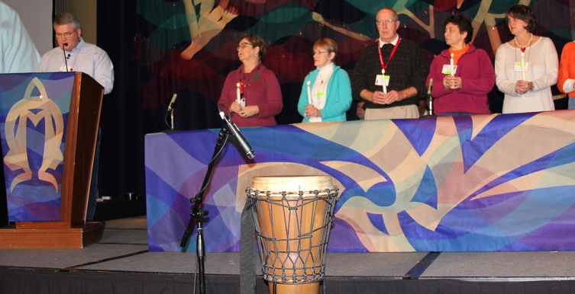
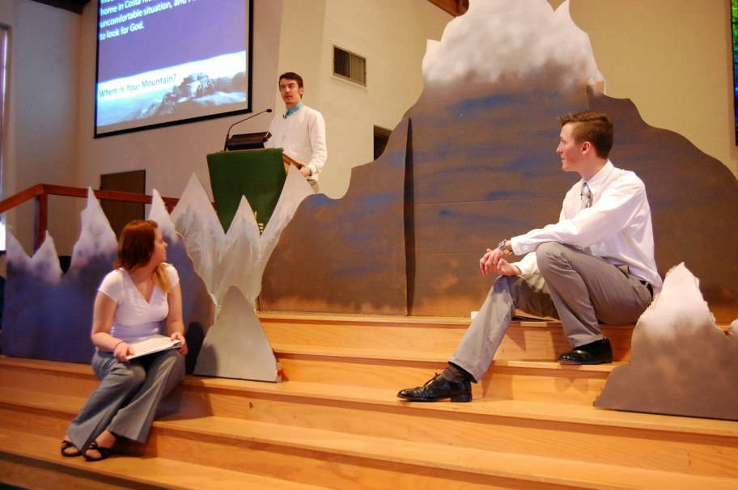
Making a difference
Network Grants
Designed for a group responding to Jesus’ call who are passionate about a common interest or concern. With preference given to first-time applicants, it is expected that a network will become self-funded over time.
Study Grants
Supports students (both undergraduate and graduate) who are members of the Presbyterian Church (U.S.A.). The purpose is to enable them to participate in “action/reflection” experiences in this country or abroad as part of the student’s journey in discovering God’s call.
Association of Presbyterian Church Educators
Brotherhood Insurance Partnership
Profits generated by Brotherhood Insurance are given back to the Synod and then shared with those entities that participate in the program. In a recent year, nearly $84,000 was distributed back to our churches, camps and presbyteries.
West Virginia University
6

Slide 7
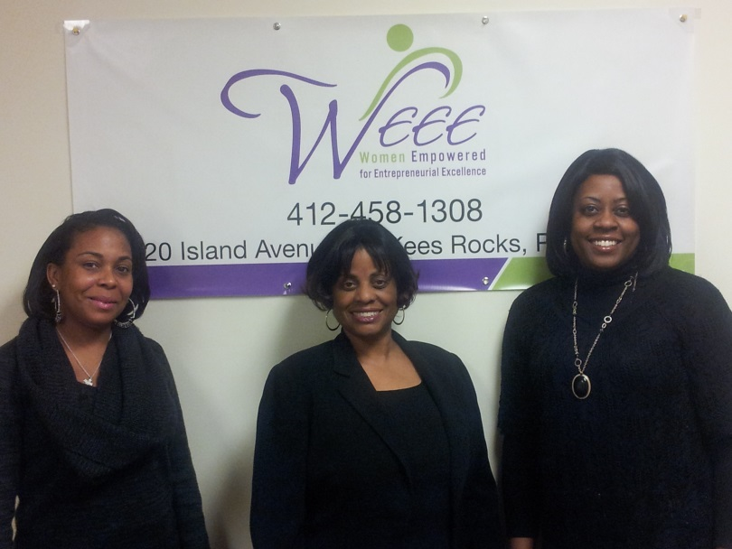
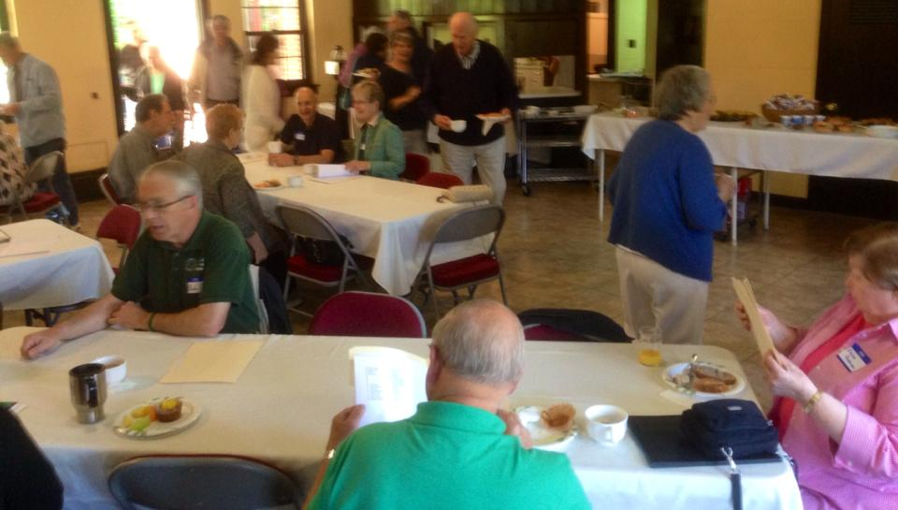
Making a difference
Self-Development of People
A ministry that affirms God’s concern for humankind. United in faith and action through sharing, confronting and enabling, SDOP includes Presbyterians and ecumenical partners dissatisfied with poverty and oppression. The committee has handed out over $600,000 to worthy organizations in the last 10 years and as much as $75,000 in a given year.
Small Church Leadership Development
Funds are provided to our presbyteries to distribute to their smaller congregations (membership of 151 or less) for the training of clergy and lay leadership. Recently, the Synod distributed $32,000 to its presbyteries for this purpose.
Women Empowered for Entrepreneurial Excellence
West Virginia’s Small Church Conference
7

Slide 8
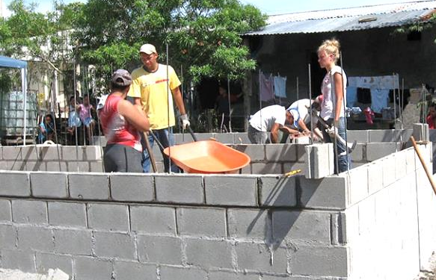
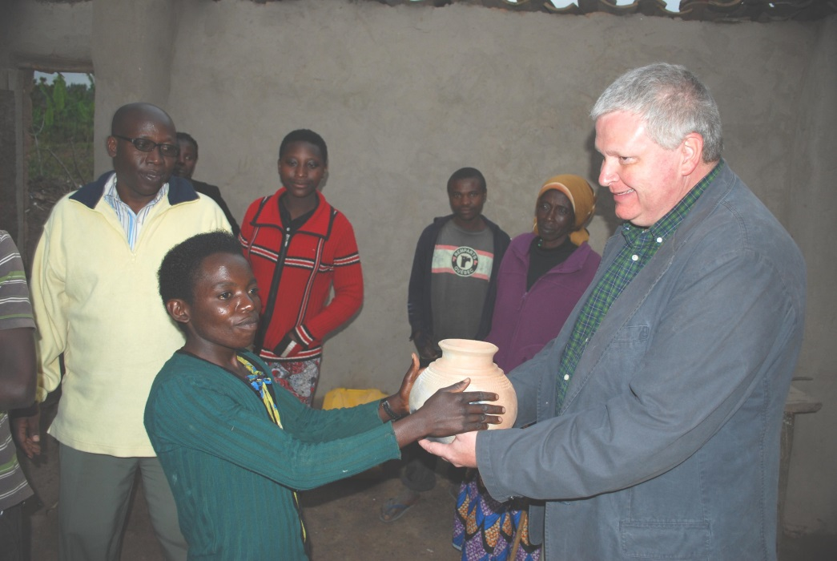
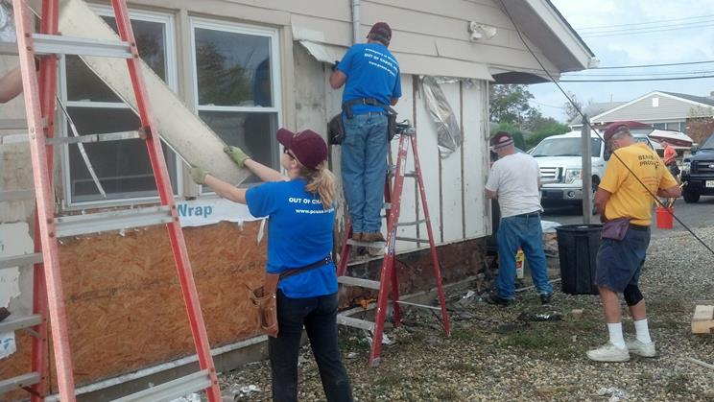
Being more
Reaching out to the world is at the core of the gospel and is a significant commitment of the Synod’s presbyteries and congregations, which have relationships and partnerships all over of the world.
As just one example, a Synod grant helped support a six-month stay of a preacher in Rwanda who strengthened the bond between church and presbytery. Grants have assisted mission travel for many groups within the Synod that have been called to build partnerships with Christians in Africa, Central America and the Middle East, as well as in the United States
Presbytery of Carlisle in Honduras
Presbytery of Kiskiminetas in Rwanda, Africa
Lehigh Presbytery in Point Pleasant, N.J.
8

Slide 9
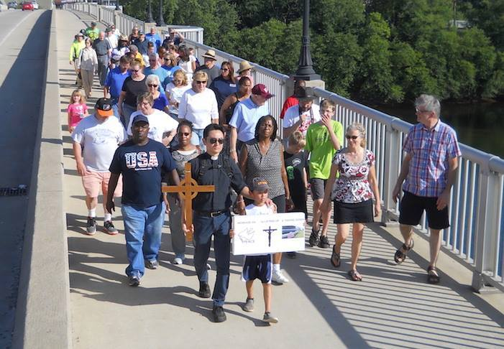
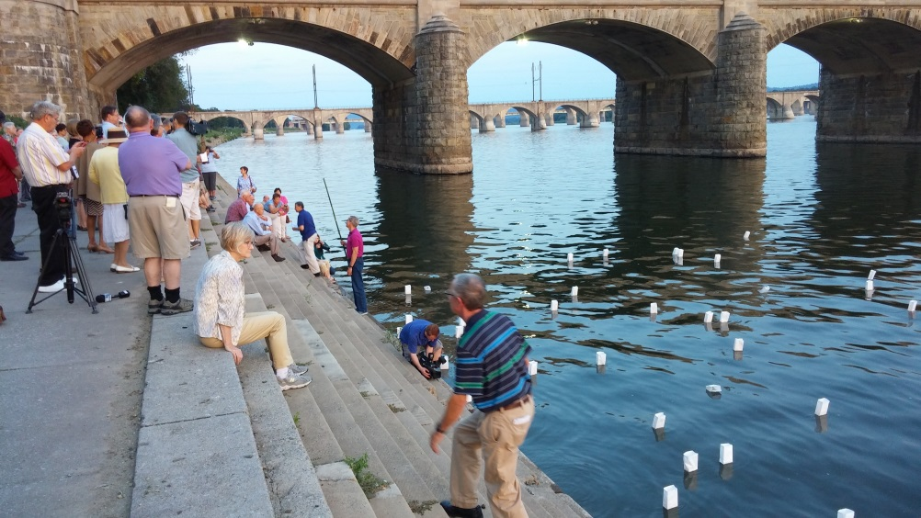
Coming together
The Synod of the Trinity, its presbyteries and churches are committed to being involved in conversations that bring to light civil and social issues that plague our world today. We pray that raising awareness with a push toward action will make a difference for Christ in our local communities and beyond.
At a Synod Assembly meeting, prayer and conversations centered around the shooting deaths of nine people at a Bible study in a Methodist church in Charleston, S.C. A congregation within our bounds created a remembrance to the lives lost during one of the world’s most deadliest acts of war – the bombing of two Japanese cities that resulted in the deaths of 120,000 people. We as a region continue to gather, talk and look to the future for ways that lead to action and living in faith.
Hiroshima/Nagasaki Remembrance
Market Square PC in Harrisburg, PA
Walk for Peace & Unity by Williamsport Presbyterian Church
9

Slide 10
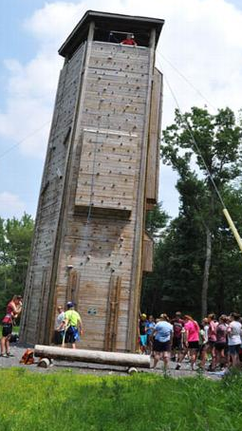
Nurturing
There are 11 camp and conference centers within the Synod’s region. They have direct partnerships with specific presbyteries and receive regular financial support from Synod grants.
Beaver Creek Presbyterian Church Camp
Upper Ohio Valley Presbytery
Bluestone Camp and Retreat
West Virginia Presbytery
Camp Donegal
Donegal Presbytery
Camp Lackawanna
Lackawanna Presbytery
Camp Lambec
Beaver-Butler, Lake Erie,
Kiskiminetas, Shenango Presbyteries
Camp Presmont
Upper Ohio Valley Presbytery
Crestfield Camp & Conference Center
Pittsburgh Presbytery
Kirkwood Camp & Conference Center
Lehigh, Philadelphia Presbyteries
Krislund Camp & Conference Center
Carlisle, Huntingdon,
Northumberland Presbyteries
Pine Springs Camp
Redstone, Washington Presbyteries
Westminster Highlands
Beaver-Butler, Lake Erie,
Kiskiminetas, Shenango Presbyteries
Crestfield Camp &
Conference Center
Krislund Camp & Conference Center
Westminster
Highlands
10

Slide 11
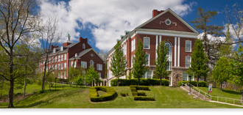
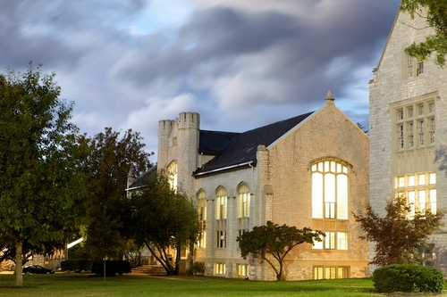
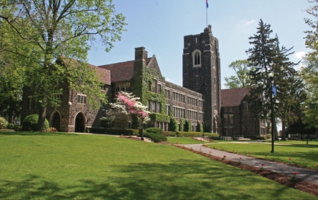
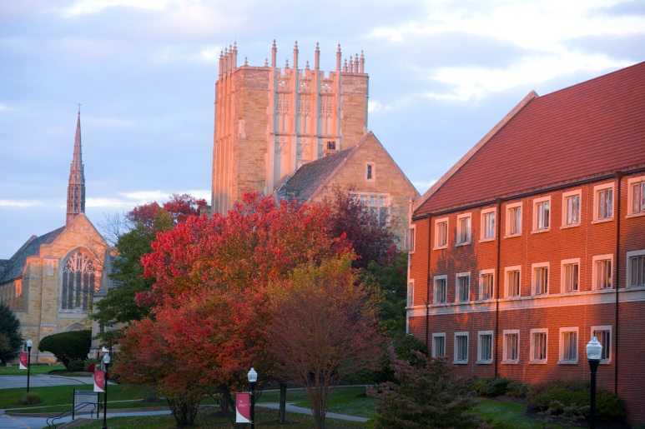
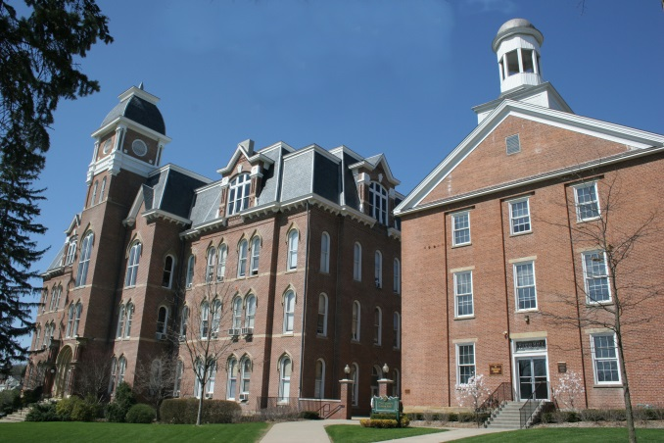
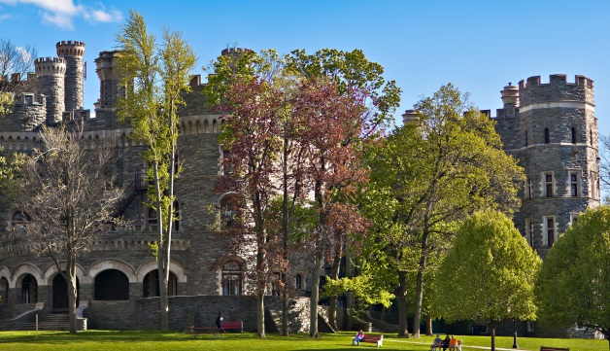
Educating
Six colleges and universities in the Synod of the Trinity region have Presbyterian affiliations and receive financial support from the Synod. While some of the Synod’s monies are placed in scholarship funds, the institutions can choose exactly how the money is used.
Wilson College,
Chambersburg, PA
Davis & Elkins College,
Elkins, WV
Westminster College,
New Wilmington, PA
Waynesburg University,
Waynesburg, PA
Arcadia University,
Glenside, PA
Grove City College,
Grove City, PA
11

Slide 12
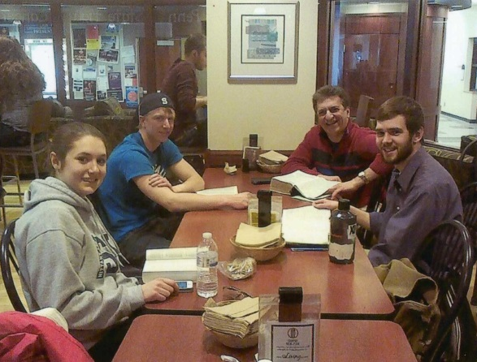
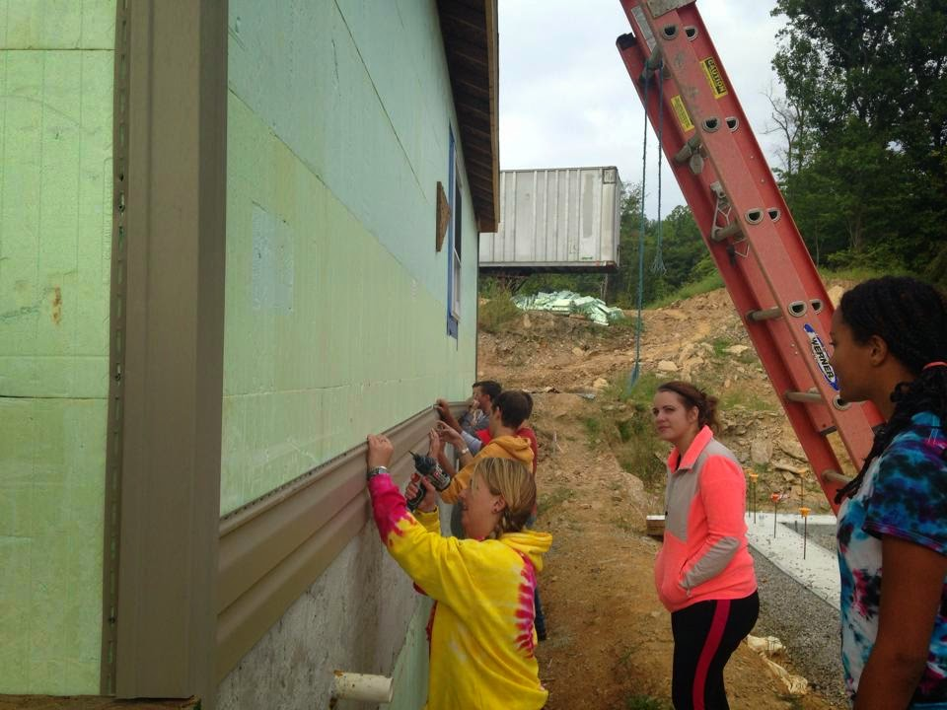
Educating
Synod funds are also given to several other colleges and universities within our bounds to support Campus Ministries. In some cases, the funds go toward the salaries of the college chaplains and help cover programming costs.
Bloomsburg University
Protestant Campus Ministry
California University of PA
United Campus Ministry
Lock Haven University
Protestant Campus Ministry
Mansfield University
Protestant Campus Ministry
Millersville University
United Campus Ministry
Penn College
United Campus Ministry
Penn State Behrend
Protestant Campus Ministry
Penn State Eberly/Fayette
Protestant Campus Ministry
Penn State University
Westminster Presbyterian Fellowship
Shippensburg University
United Campus Ministry
Campus Ministry at
Penn State Behrend
In West Virginia, the Westminster Foundation supports several universities in the state. The Synod provides funds to the Foundation, which in turn passes them on to those schools’ Campus Ministries.
Davis & Elkins College
Fairmont State University
Marshall University
Pierpont Community and Technical College
Shepherd University
West Liberty University
West Virginia University
Weekend of Service at
West Virginia University
12

Slide 13
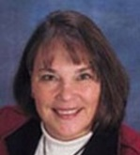
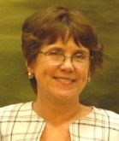
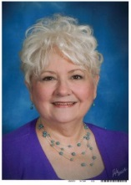
Serving
Synod of the Trinity On the web
3040 Market Street www.syntrinity.org
Camp Hill, PA 17011 Facebook.com/synodofthetrinity
Ph: (717) 737-0421 @SynodTrinity
Rev. Susan Faye Wonderland
Transitional Executive
swonderland@syntrinity.org
Chantal Atnip
Treasurer
treasurer@syntrinity.org
Gwenn Egresitz
Administrative Assistant
Bookkeeper
gegresitz@syntrinity.org
Rev. Dr. Wayne A. Yost
Stated Clerk
wyost@syntrinity.org
Catherine Gray
Administrative Assistant
cgray@syntrinity.org
Mike Givler
Communications Coordinator
mgivler@syntrinity.org
13

