Slide 1
What the Church Needs to Know about Hate Groups
Why here? Why now? Why us?
Ann Van Dyke Community Responders Network

Slide 2
Whom shall I send and who will go for me?

Slide 3
What is hate?
"Hate is the inability to tolerate the presence of difference in others.“
What is prejudice?
"Prejudice is the belief that we know a great deal about someone whom we do not know."

Slide 4
Characteristics of
Organized Supremacist Groups
Loosely structured local groups to highly structured international groups.
Leaders often project a mainstream image.
Skinheads, although usually not official members, often are loosely affiliated with these groups.
Focus on issues of concern to Middle America as a cover for their aims.
Examples include KKK and Neo Nazis.
Right to organize protected under the 1st Amendment.

Slide 5
First Amendment Issues

Slide 6
First Amendment Issues
In many circumstances, we cannot outlaw hate speech in the United States.
What then do we do?

Slide 7
To understand that extremist groups are a SYMPTOM of a larger problem and to understand not just what is happening, but why.
The Goal:

Slide 8
Changing demographics
Conflicts over immigration
Struggling economy/loss of jobs
Backlash against the first Black President
White supremacist rhetoric during the 2016 presidential campaign

Slide 9
The List of Human Difference that Hate Groups Cannot Tolerate:
Jewish Community All immigrants
African Americans LGBT community
Muslims People with handicaps/disabilities
All people of color Strong women
All religious minorities People in "mixed" relationships

Slide 10
“All hate groups have beliefs or practices that attack or malign an entire class of people, typically for their immutable characteristics.”
-Source: Southern Poverty Law Center

Slide 11
Triggering Conditions
Fear of changing population (insiders v. outsiders).
Struggling economy (existing problems).
Disconnection (alienated youth).
Failure of Community Leaders to Address:
Positives
Negatives
Silence.

Slide 14
40

Slide 15
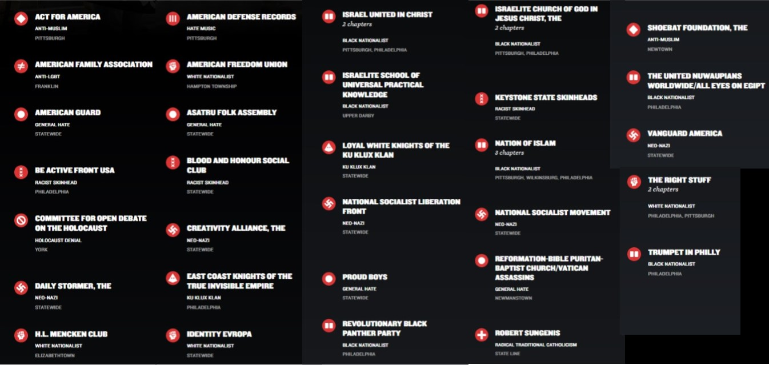
Pennsylvania Groups

Slide 16
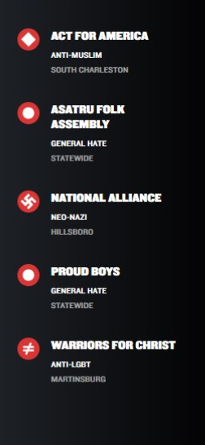
In 2018, five hate groups were detected in West Virginia.
40

Slide 17
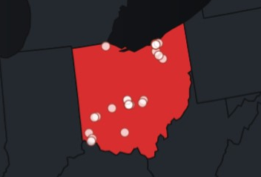
Ohio had 36 hate groups being tracked in 2018.
40

Slide 18
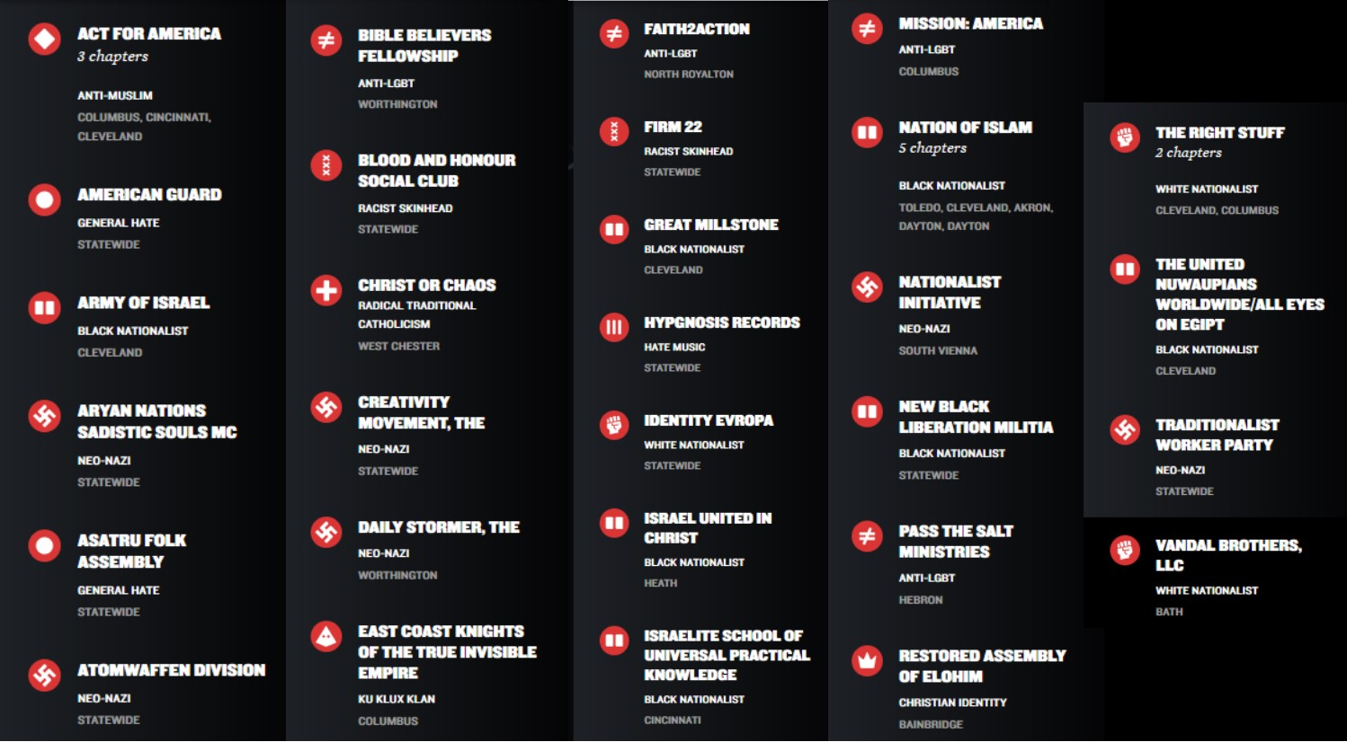
Ohio Groups

Slide 21
Largest and most active Neo Nazi hate group in the United States
50+ chapters located throughout the US
Creation of “Viking Youth Corps”

Slide 22
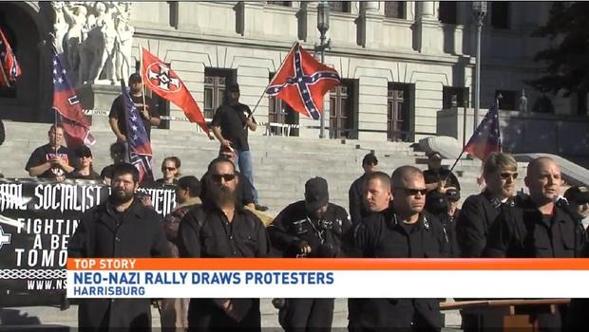

Slide 23
Aryan Nationalist Alliance
Formed in spring of 2016
Seeks to be an umbrella group.
Coordinates rallies.
Goal: "To create an ethno state where each racial group could govern themselves."

Slide 27
Stormfront.org

Slide 28
DailyStormer.com
Bills itself as “America's #1 Most-Trusted Republican News Source.”
Headlines include: “All Intelligent People in History Disliked Jews” and “Adolf Hitler: The Most Lied About Man of All Time.”
Founded in 2013, readers now spend more time on the site than they do on Stormfront.
On a slow day, more than 10,000 log on.
Daily Stormer also reaches a younger and wealthier demographic.

Slide 29
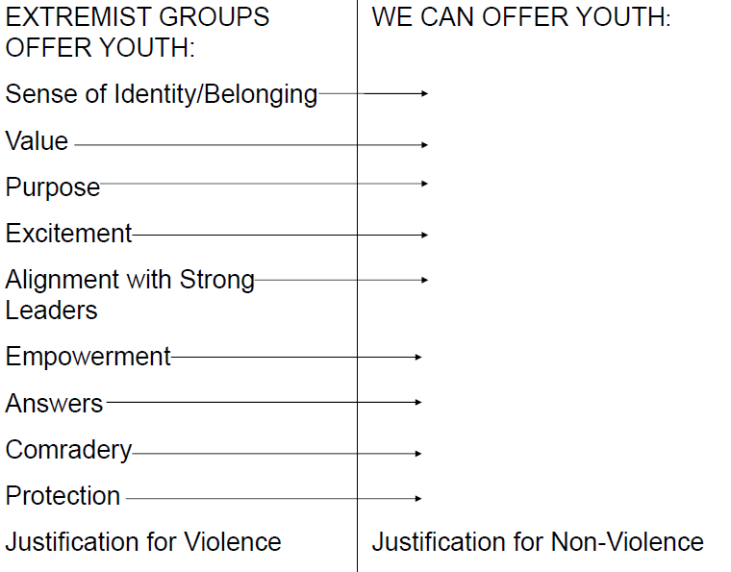

Slide 30
FBI Offender Typology
Thrill Seekers
Reactive Offenders
Mission Offenders

Slide 31
“My experience in the extreme right was that of being around my own, the untreated mentally ill. PTSD mostly from their childhoods, rampant sexual abuse from childhood, manic depression, drug abuse, alcoholism, paranoid schizophrenia, clinical depression, you name the mental illness and it is there and generally untreated. Those who have found at least short term means of functioning, generally mixtures of drugs and alcohol and/or an absolute dedication to belief structure, tend to find themselves pretty quickly advanced.” -David Edwards, Jr.

Slide 32
Defectors Tell Us…
Floyd: Hate will turn on you.
Frank: Hate comes from hurt.
Dana: Hate and violence make a miserable life.
David: There is no love in the hate movement.
Angela: I’m willing to put myself at risk to make amends.

Slide 33
Response
The best response is prevention
Getting past, "If we ignore this, it will go away."
When they are in front of my church:
-They come to intimidate. Do not cooperate. (Faking it is OK)
-Take their flyer and give them a bulletin. (Send flyer to CRN!)
-Inform the police

Slide 34
Response Part II
When they hold a rally, distribute recruitment literature or when there are anonymous acts of hatred in your area.
-Speak!
-Unite at another location
-Reach out to those who were targeted
-Turn to "A Community Response Guide" from TeachingTolerance.org -What about counter protests?

Slide 35
PREVENTION IS ANOTHER NAME FOR BUILDING COMMUNITY
-Look for those triggering conditions
-Establish ongoing partner congregations
-Tend to your alienated youth
-Know thyself
-Practice "Not around me."
-Go out of your way to get to know people who appear to be different
-Affirm equality and nonviolence as a spiritual matter

Slide 36
www.teachingtolerance.org – Teaching Tolerance

