Slide 1
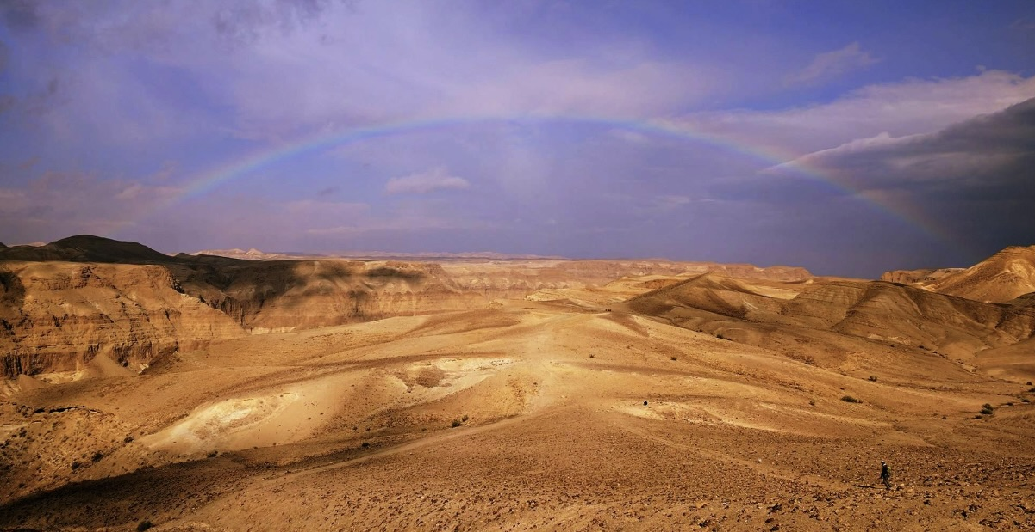
Leadership Opportunities and challenges WILDERNESS wonderings while wandering
The Rev. Ruth Faith Santana-Grace
Co-Moderator, 225th General Assembly
Presbyterian Church, USA
Synod of the Trinity
October 2023

Slide 2
Wilderness signs – COMING AT US FROM outside
OUR current CULTURAL CONTEXT – uncharted
“Emerging” from Pandemic
Resurgence of “Visible” racism
“ONCE-ASSUMED” Civility loss
Cultural unrest
“religious identity” has been in decline

Slide 3
Cultural Institutional skepticism
Dramatic shift in adults who identify as Christians – ‘Nones’ are growing
Growth in Religiously unaffiliated
Skepticism about Religious Institutions

Slide 4
Wilderness signs – COMING AT US FROM INSIDE (The Presbyterian world)
Denominational decline
Churches and Membership
Dollars
infrastructure

Slide 5
Wilderness Challenge – #1: Leading from A ‘RE-FORMATION’
“Christianity is currently undergoing a massive upheaval as part of a regular pattern that occurs every 500 years, in which old ideas are rejected and new ones emerge. Ultimately, the old expression of Christianity is refurbished and revitalized, while a new, more vital form also is created” The Great Emergence BY Phyllis Tickle

Slide 6
Wilderness CHALLENGE FOR US “Decent and in order” folk – #2: We cannot “program” our way through this
“Liminal seasons cannot be powered through. They must be attended to, and the leader must approach the season with a stance of unknowing and wonder. We work our way through liminal space with a discerning mindset, not a decision making mindset. This can be scary for leaders because it requires yielding and a different kind of doing.“ (SUSAN BEAUMONT)

Slide 7
Wilderness Challenge #3: leading Between the “here” and the “Not yet” A SEASON OF LIMINAL SPACE
…a unique position where human beings hate to be but where the biblical God is always leading them. It is when you have left the tried and true, but have not yet been able to replace it with anything else. It is when you are finally out of the way. It is when you are between your old comfort zone and any possible new answer. If you are not trained in how to entrust and wait, you will run…anything to flee this terrible cloud of unknowing. RICHARD ROHR

Slide 8
Our Corporate Temptations To wilderness wanderings (default responses to stress)
Looking for new Gods – new absolutes (Exodus 32)
Romanticizing the Good old days - onions and slavery look good (numbers 11)
These leaders have to go – blame game ((numbers 14)

Slide 9
The truth about the wilderness
We don’t go into and through the wilderness to die!
Wilderness allows us to create the space to create and re-create a new identity
Wilderness is the place from which we emerge renewed to take on a new land

Slide 10
This is the time we’ve been gifted and given
We’ve been called for a time such as this!
What will we do with our moment in time?
(Paleontology)

Slide 11
Our leadership options
Do nothing and hope (this is a decision)
Try to STOP A RE-FORMATION
Recite the SEVEN DEADLY WORDS -“WE NEVER DID IT THAT WAY BEFORE”.
CHOOSE TO stay bounded by AN ILLUSION OF WHAT HAS BEEN (LAMENTING AND POWERLESS)
hide in aSSUMPTIONS, fear, self-righteousness and cynicism
Try to “CANOE THE MOUNTAINS” – instead of using NEW NAVIGATIONAL TOOLS (TODD BOLSINGER) OR

Slide 12
….OR as leaders, we can
Affirm that we believe that God’s plans for us are bigger than what we can see or envision?
Embrace THIS AS A SEASON OF unmapped OPPORTUNITIES – THERE WILL BE RISKS AND WE WILL FAIL
Lean into what we have – not what we do not have (resisting the theology of scarcity) – BE CREATIVE
ASK TOUGH QUESTIONS: What aRE WE INVITING OTHERS TO? WHAT ARE WE SERVING?
ENJOY THE JOURNEY - HAVE FUN!

Slide 13
A word of en-courage-ment
May your life in the wilderness
be framed by:
dreaming dreams (joel 2)
Collaborating (Mark 6:7; Luke 10:1-3)
Sharing your story (Deuteronomy 6:7)

Slide 14
Remember who you are!
a resurrection People –
a People of the impossible
UNBOUNDED WE THRIVE!

