Slide 1

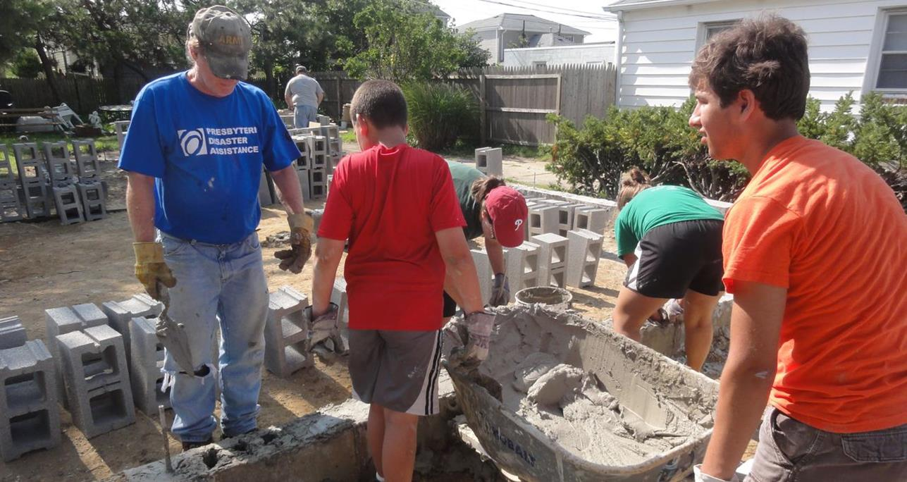
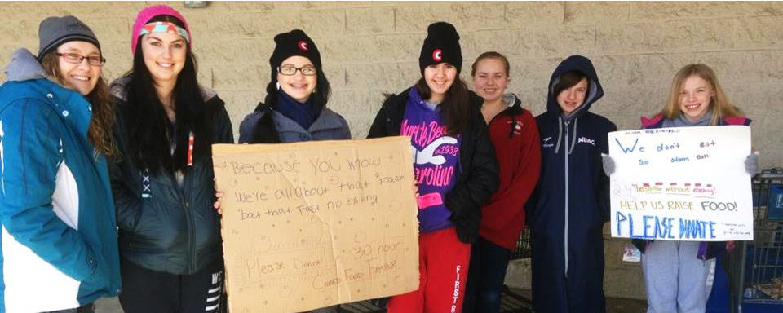

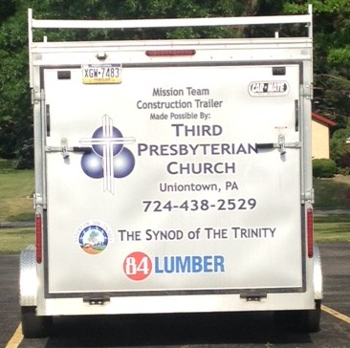
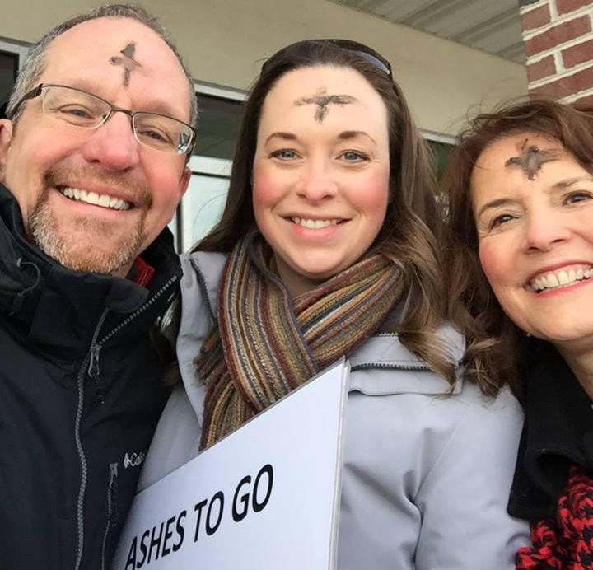

Slide 2

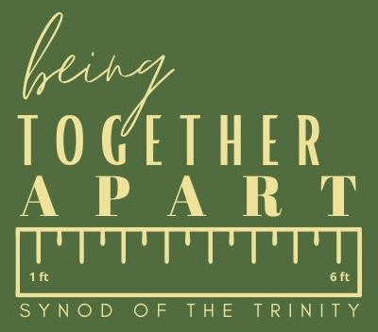
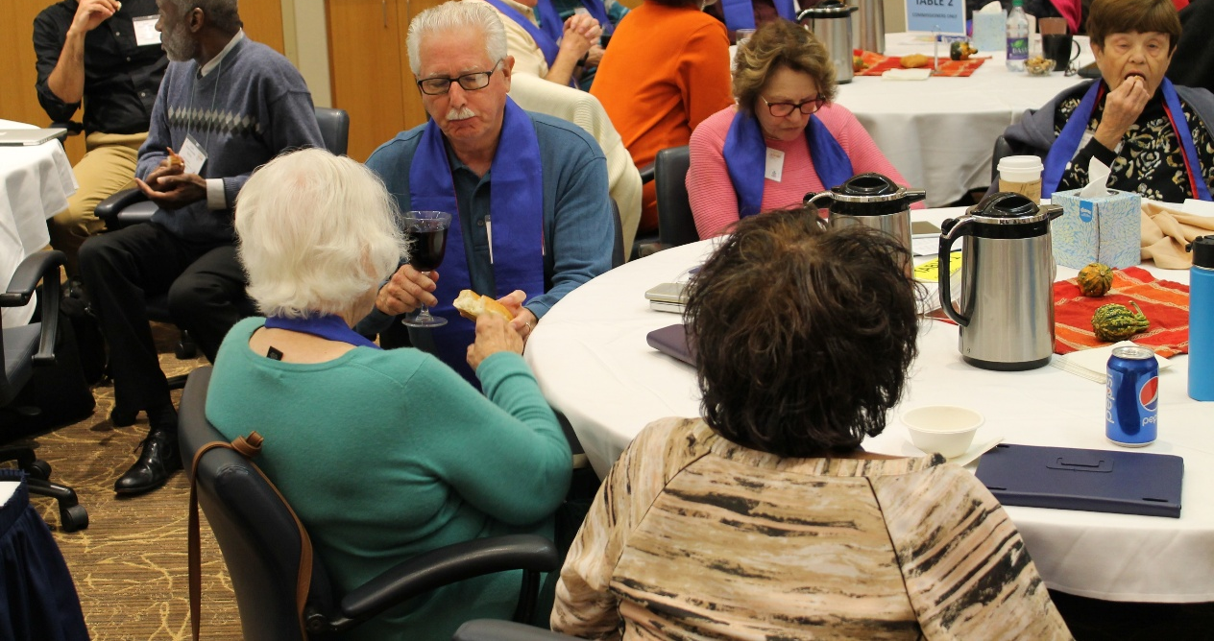
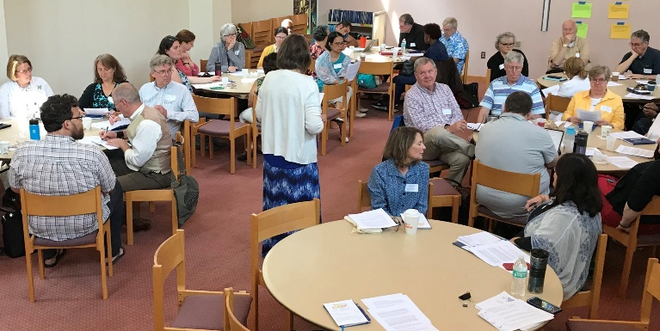
Supporting
For more than 300 years, the Synod of the Trinity has been a nurturing source of support and resources for its presbyteries as they seek to be faithful to Christ’s commission in their support of vital, mission-oriented congregations.
We work hand-in-hand with the ministry and mission of our presbyteries as they seek to support the witness of congregations, to the end that the church throughout its region becomes a community of faith, hope, love and witness.
The Synod supports presbytery leadership by offering training, networking and continuing education opportunities such as: executive presbyter forums; COM/CPM, PJC and General Assembly trainings; cost-sharing for education for first-time presbytery executives and access to demographic ministry analysis.
Virtual work slogan
during the pandemic
In addition, the Synod participates in objectives relating to the larger mission strategies of the Presbyterian Church (U.S.A.) General Assembly.
Partaking of Communion
at the Synod Assembly
Regional Gatherings
2

Slide 3
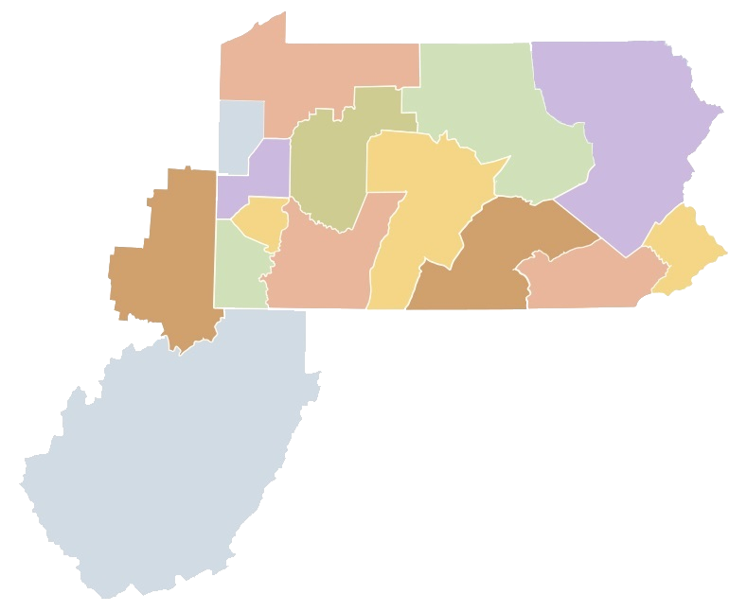
Supporting
The Synod of the Trinity region covers all of Pennsylvania, most of West Virginia except for the eastern panhandle, and the counties of eastern Ohio (with West Virginia’s northern panhandle) generally known as the Upper Ohio Valley.
Lake Erie
Shenango
Northumberland
Mountain
Laurel
Pittsburgh
Beaver-Butler
Kiskiminetas
Huntingdon
Upper
Ohio
Valley
Carlisle
Philadelphia
Redstone
Donegal
Washington
Local proximity issues have also resulted in congregations in New York and Maryland being included in the Synod’s numbers. Our current 15 presbyteries make up the Synod of the Trinity, and these “mid council offices” serve 1,007 churches and 110,278 Presbyterians, making the Synod of the Trinity not only the oldest but also one of the largest in the Presbyterian Church (U.S.A.).
West
Virginia
3

Slide 4
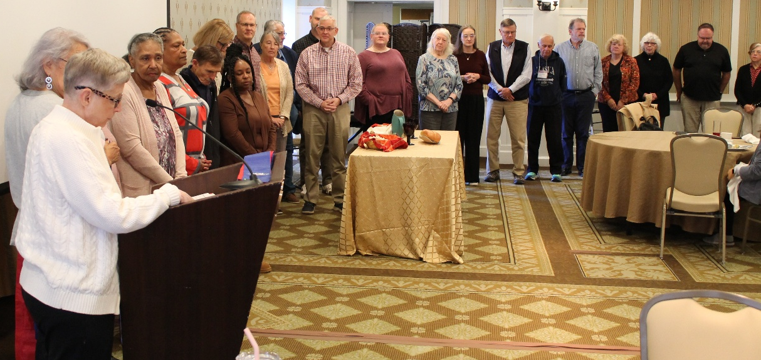
Our calling
Synod’s primary end:
As part of the body of Christ, The Synod of the Trinity, through the responsible use of shared resources, supports and challenges presbyteries to be vital, innovative and faithful in their collaborative and distinctive callings.
Secondary ends:
Connecting presbytery leadership for coordination, spiritual support and sharing best practices.
Encouraging innovation in, between and among presbyteries through the use of human, programmatic and financial resources.
Providing services of education and nurture for presbyteries.
Encouraging partnerships among presbyteries in joint and shared mission and ministry.
Nurturing relationships within the larger church for the purpose of greater witness.
Fostering conversation and mutual understanding among presbyteries for action toward and promotion of justice and righteousness. (Amos 5:24-25)
Denotes an end that has been emphasized for the work of the Synod by the Governing Commission.
Leading
The Synod Assembly is comprised of 32 commissioners representing each of the Synod’s 15 presbyteries plus six racial ethnic at-large commissioners.
Synod commissioners gather
at a Synod Assembly
4

Slide 5
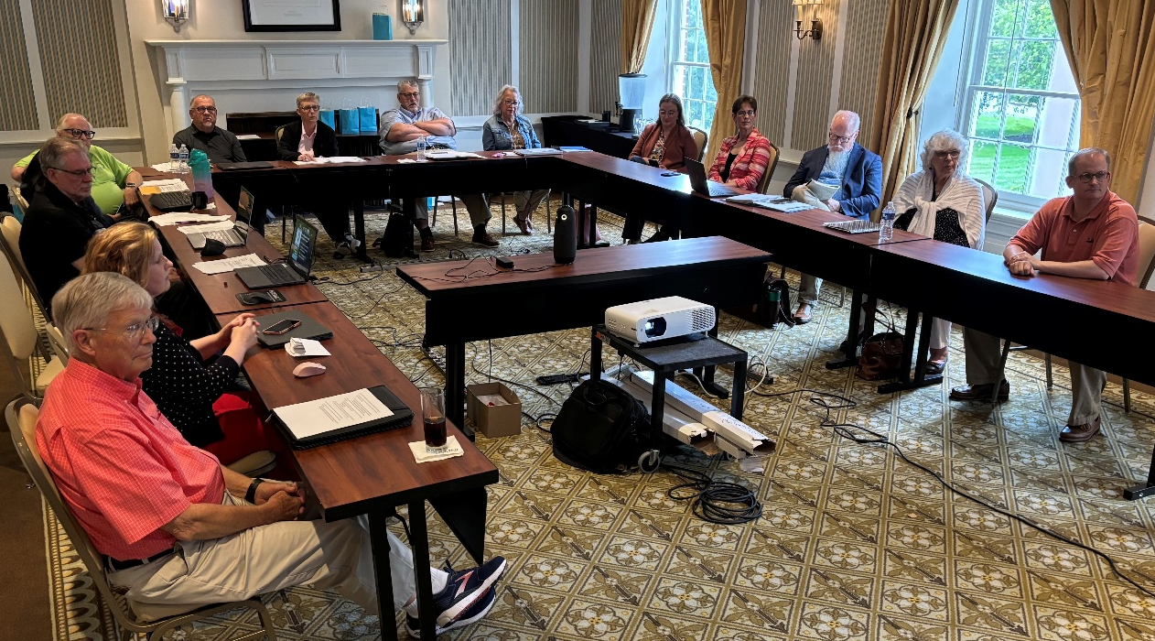
Leading
Since 2015, the Synod of the Trinity has been following a model of governance and leadership created by John and Miriam Carver called “Policy Governance.” This format is based on four philosophical pillars:
Accountability
Servant Leadership
Clarity of Group Values
Empowerment
Through this governance model, the Synod’s primary stakeholders are its member presbyteries and their congregations, whom the Carvers label as “owners.” A Governing Commission (a leadership board acting on behalf of the Synod Assembly throughout the year) attends to the Synod’s primary documents while the Synod executive leads and works closely with staff and volunteers to implement the Synod’s ends.
The Governing Commission consist of the Synod’s
co-moderators, eight elected commissioners, five ex-officio (four Synod staff members plus the previous
co-moderator) and two advisory executive presbyters.
Governing Commission gathering in Bedford, PA
4

Slide 6
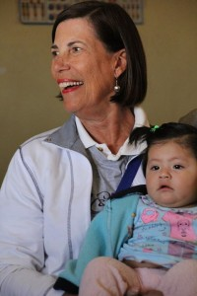
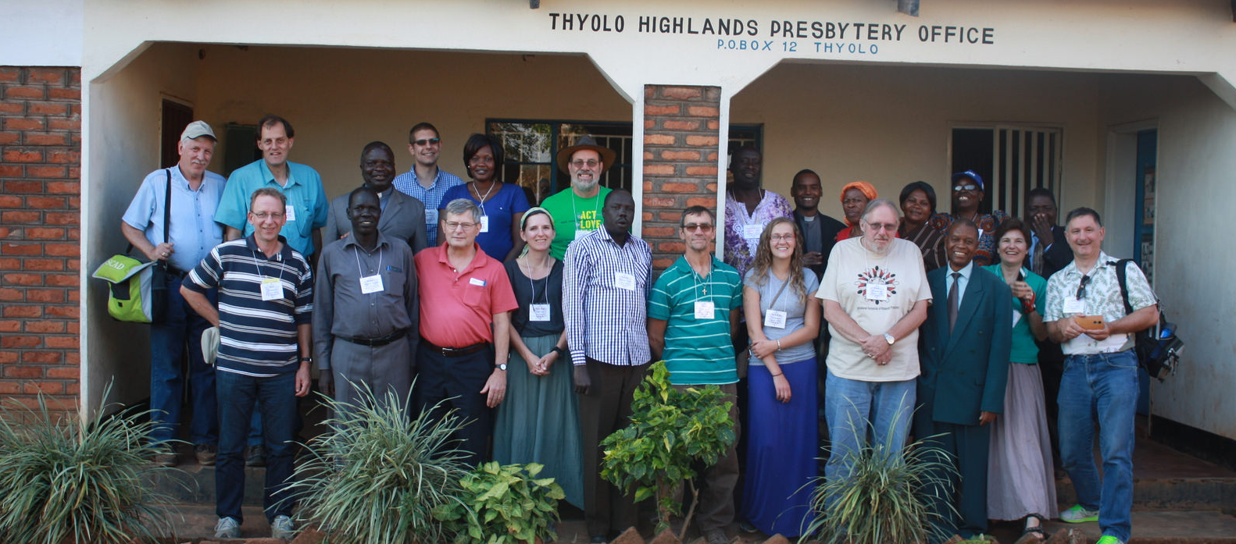
Making a difference
Each year, the Synod of the Trinity awards hundreds of thousands of dollars to presbyteries and churches. Moneys are generally distributed in the following ways:
Justice & Righteousness Grants
This grant is designed to promote conversation or action that leads to greater justice and righteousness in the church and the wider world. Efforts may include direct action, preventive measures, community education and heightening awareness.
Mission Travel Grants
Short-term mission trip travel represents a special kind of experience, and the Synod of the Trinity wants to help congregations and individuals put faith into action through this grant.
First PC of Charleston, WV, in Peru
Pittsburgh and Beaver-Butler Presbyteries in Malawi, Africa
5

Slide 7
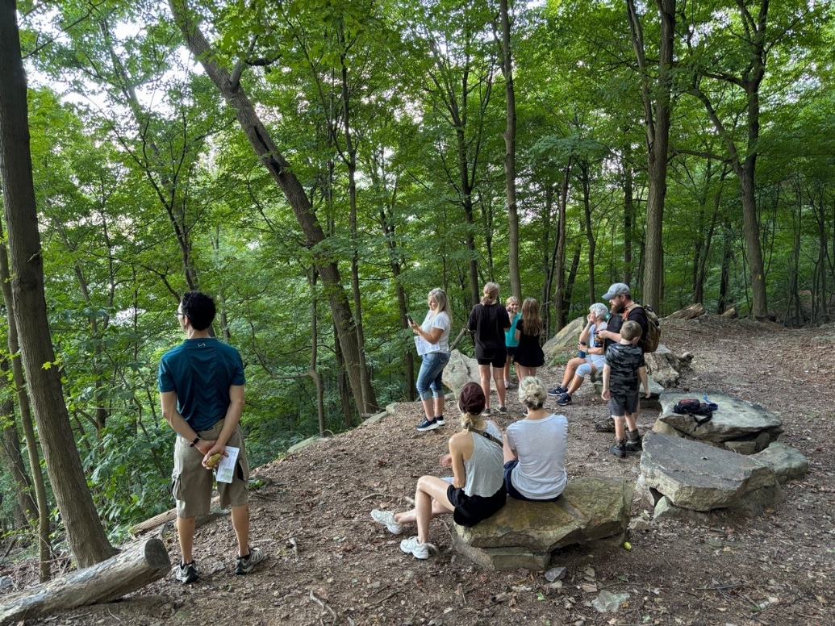
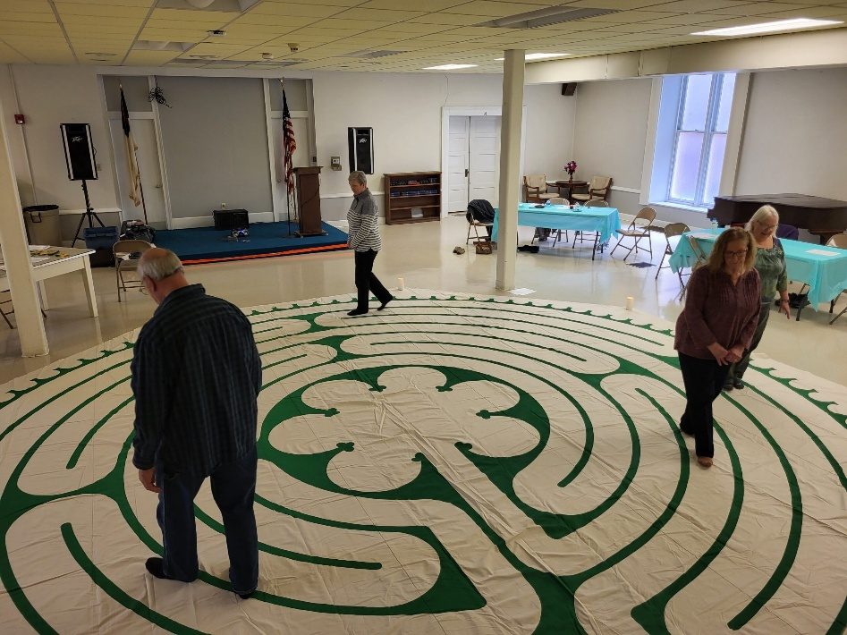
Making a difference
Innovation Grants
Through these one-time grants, congregations, presbyteries and faith-based organizations are encouraged to dream and explore innovative and new possibilities for ministry and mission. Applicants are encouraged to brainstorm new project initiatives intent on building the church’s capacity without the fear of failure.
Ecumenical Relationships Grant
Guided by the Synod’s fifth end (“Nurturing relationships within the larger church for the purpose of greater witness”), the Ecumenical/Wider Church Grant is designed to encourage joint and shared ministry and mission in local communities among ecumenical partners.
Intertwined Outdoor Ministry
Traveling Labyrinth
in Upper Ohio Valley
6

Slide 8
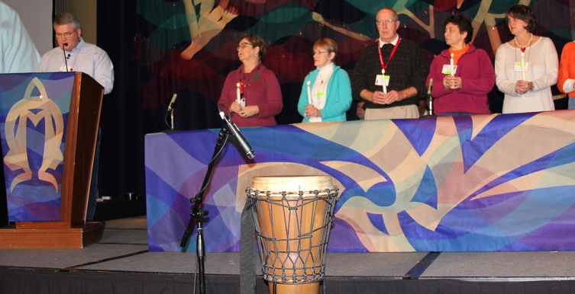
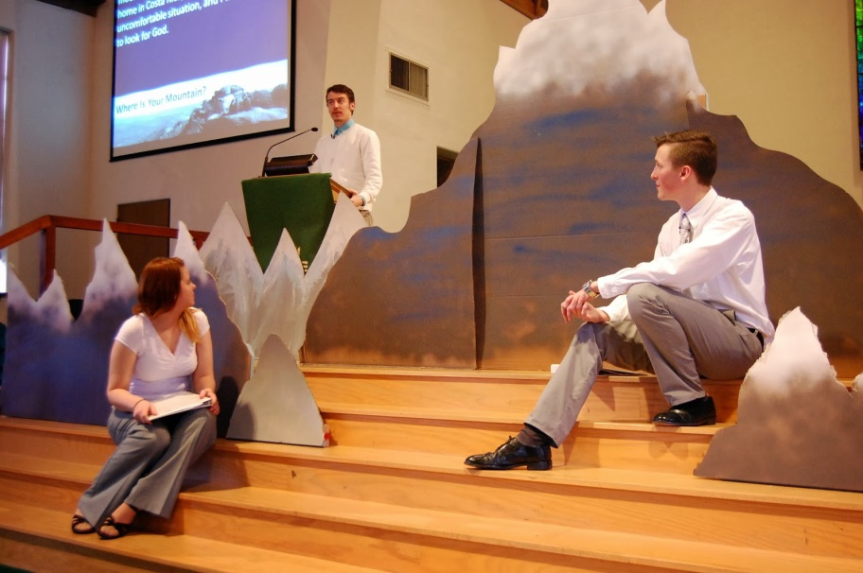
Making a difference
Partnership Grants
The Partnership Grant is designed to encourage joint and shared ministry and mission by groups of people from different organizations, congregations and presbyteries.
Education & Nurture Grants
This opportunity is designed specifically to support undergraduate and seminary scholarships, camperships and new programming for regional PC(USA) camps, congregational efforts that address local educational needs and similar endeavors.
Association of Partners in Christian Education
West Virginia University
7

Slide 9
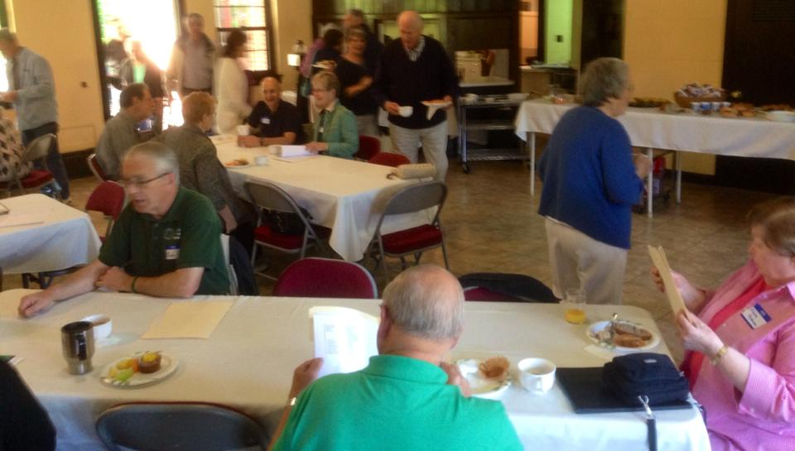
Making a difference
Small Church Leadership Development
Funds are provided to our presbyteries to distribute to their smaller congregations (membership of 100 or less) for the training of clergy and lay leadership. Each year, the Synod distributes as much as $32,000 to its presbyteries for this purpose.
Brotherhood Insurance Partnership
Profits generated by Brotherhood Insurance are given back to the Synod and then shared with those entities that participate in the program. Annually, $50,000 is distributed back to our presbyteries.
West Virginia’s Small Church Conference
8

Slide 10
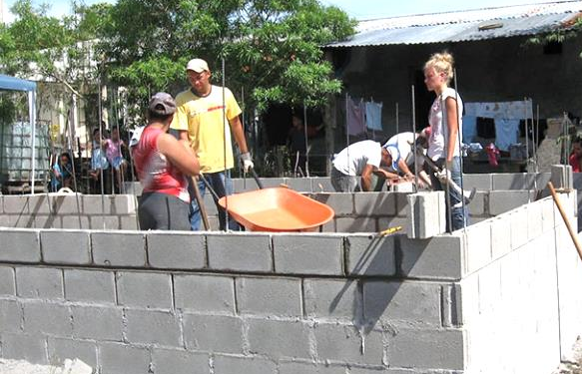
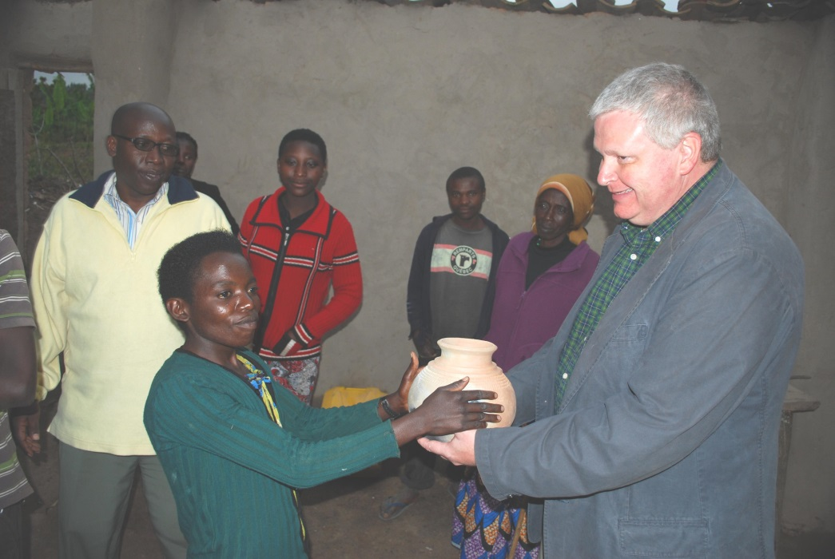
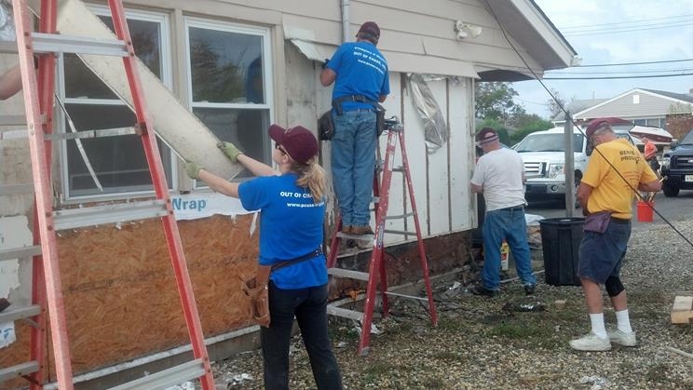
Being more
Reaching out to the world is at the core of the gospel and is a significant commitment of the Synod’s presbyteries and congregations, which have relationships and partnerships all over of the world.
As just one example, a Synod grant helped support a six-month stay of a pastor in Rwanda who strengthened the bond between church and presbytery. Grants have assisted mission travel for many groups within the Synod that have been called to build partnerships with Christians in Africa, Central America and the Middle East, as well as in the United States.
Presbytery of Carlisle in Honduras
Presbytery of Kiskiminetas in Rwanda, Africa
Lehigh Presbytery in Point Pleasant, N.J.
9

Slide 11
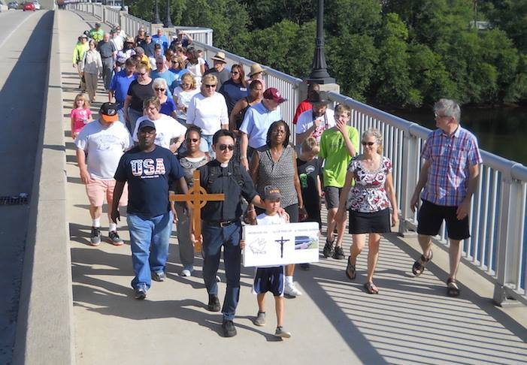
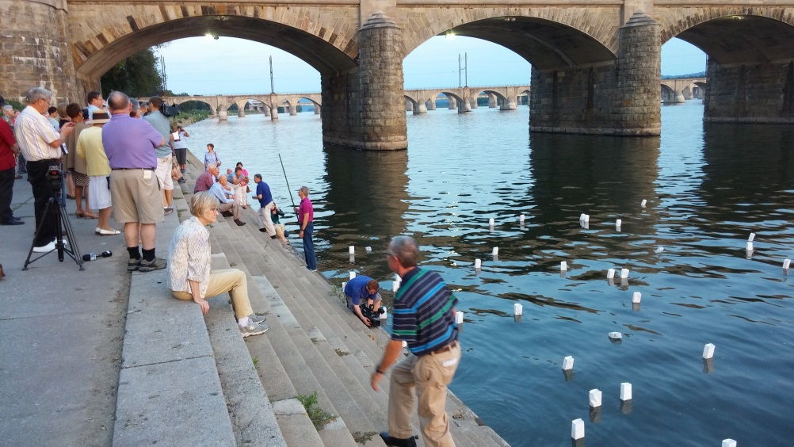
Coming together
The Synod of the Trinity, its presbyteries and churches are committed to being involved in conversations that bring to light civil and social issues that plague our world today. We pray that raising awareness with a push toward action will make a difference for Christ in our local communities and beyond.
At Synod Assembly meetings, prayer and conversations center around racial and social issues that are plaguing our nation. A congregation within our bounds created a remembrance to the lives lost during one of the world’s deadliest acts of war — the bombing of two Japanese cities that resulted in the deaths of 120,000 people. We as a region continue to gather, talk and look to the future for ways that lead to action and living in faith.
Hiroshima/Nagasaki Remembrance
Market Square PC in Harrisburg, PA
Walk for Peace & Unity by Williamsport Presbyterian Church
10

Slide 12
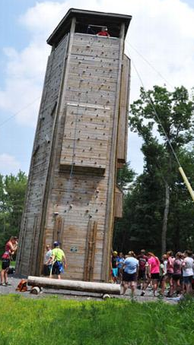

Nurturing
There are eight camp and conference centers within the Synod’s region. They have direct partnerships with specific presbyteries and receive regular financial support from Synod grants.
Beaver Creek Presbyterian Church Camp
Upper Ohio Valley Presbytery
Bluestone Camp and Retreat
West Virginia Presbytery
Camp Lackawanna
Lackawanna Presbytery
Camp Lambec
Beaver-Butler, Lake Erie,
Kiskiminetas, Shenango Presbyteries
Camp Presmont
Upper Ohio Valley Presbytery
Crestfield Camp & Conference Center
Pittsburgh Presbytery
Krislund Camp & Conference Center
Carlisle, Huntingdon,
Northumberland Presbyteries
Pine Springs Camp
Redstone, Washington Presbyteries
Crestfield Camp &
Conference Center
Krislund Camp & Conference Center
11

Slide 13
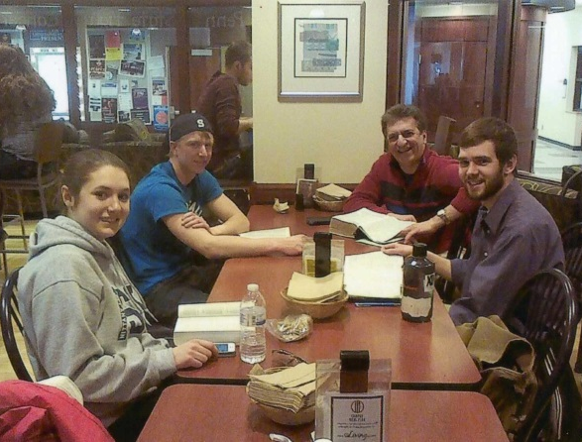
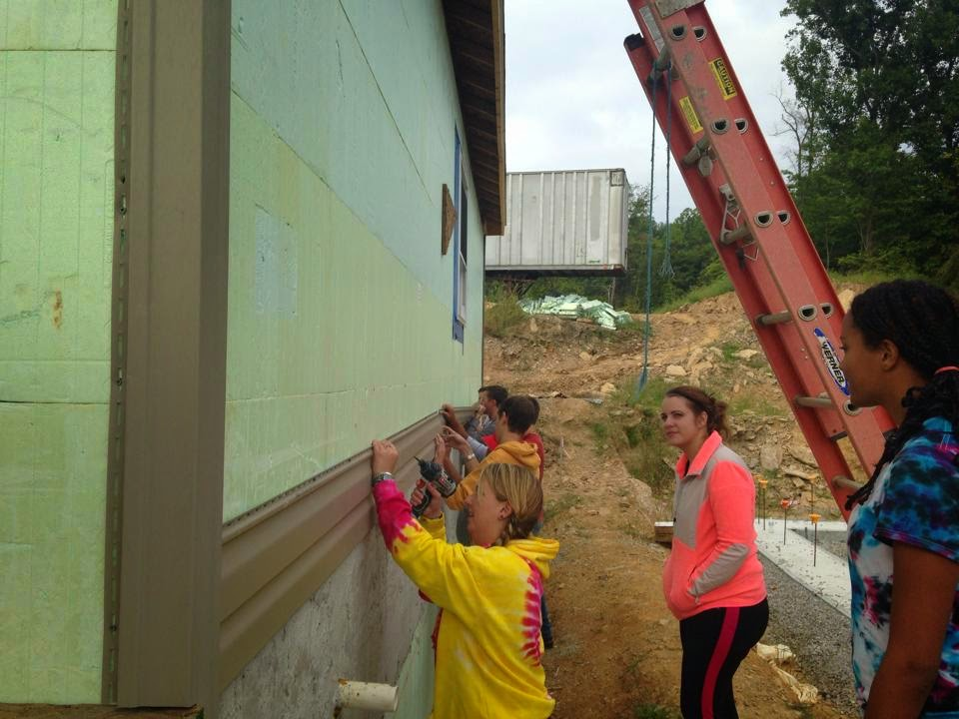
Educating
Synod funds are given to several colleges and universities within our bounds to support Campus Ministries. In some cases, the funds go toward the salaries of the college chaplains and help cover programming costs.
Bloomsburg University
Protestant Campus Ministry
Mansfield University
Protestant Campus Ministry
Penn State University
Westminster Presbyterian
Fellowship
Wilson College
Protestant Campus Ministry
West Liberty University
Protestant Campus Ministry
Westminster College
Westminster Presbyterian Fellowship
Campus Ministry at
Penn State University
The Westminster Foundation serves as the campus ministry arm of the Presbytery of West Virginia, supporting several universities in the state. The Synod provides funds to the Foundation through the presbytery, which in turn passes them on to those schools' campus ministries.
Beckley (WVU Tech)
Davis & Elkins College
Fairmont State University
Marshall University
West Virginia University
Weekend of Service at
West Virginia University
13

Slide 14
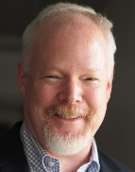
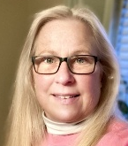
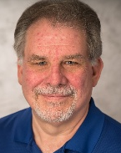
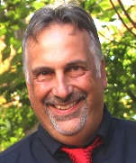
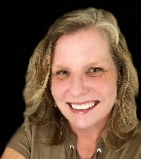
Serving
Synod of the Trinity On the web
702 East Simpson Street www.syntrinity.org
Unit 87 Facebook.com/synodoftrinity
Mechanicsburg, PA 17055 Twitter: @synodtrinity
Ph: (717) 737-0421 Instagram: synodtrinity
Rev. Forrest Claassen
Executive/Acting Stated Clerk
fclaassen@syntrinity.org
Frank Orzehoski
Business Administrator
businessadmin@syntrinity.org
Gwenn Egresitz
Administrative Assistant &
Bookkeeper/Office Services
gegresitz@syntrinity.org
Mike Givler
Communications Coordinator
mgivler@syntrinity.org
Elizabeth Connelly
Connections Coordinator
econnelly@syntrinity.org
14

